Slide 1
CMSC 471 Intro to Artificial Intelligence Spring 2024
KMA Solaiman
ksolaima@umbc.edu

Slide 2
Instructor: KMA Solaiman (Salvi)
ITE 201C/Remote
ksolaima@umbc.edu
Mon/Wed: 3 - 4 pm (TBD)
by appointment
Multimodal Information Retrieval
Vision & language processing
Learning with low-to-no supervision
Novelties in Learning Models

Slide 3
TA and Graders
Aidin Shiri
GS29333@umbc.edu
Office hours:
TBD and by appointment
Location: ITE 334
Apoorv Bansal
ZK39815@umbc.edu

Slide 4
Administrivia

Slide 5
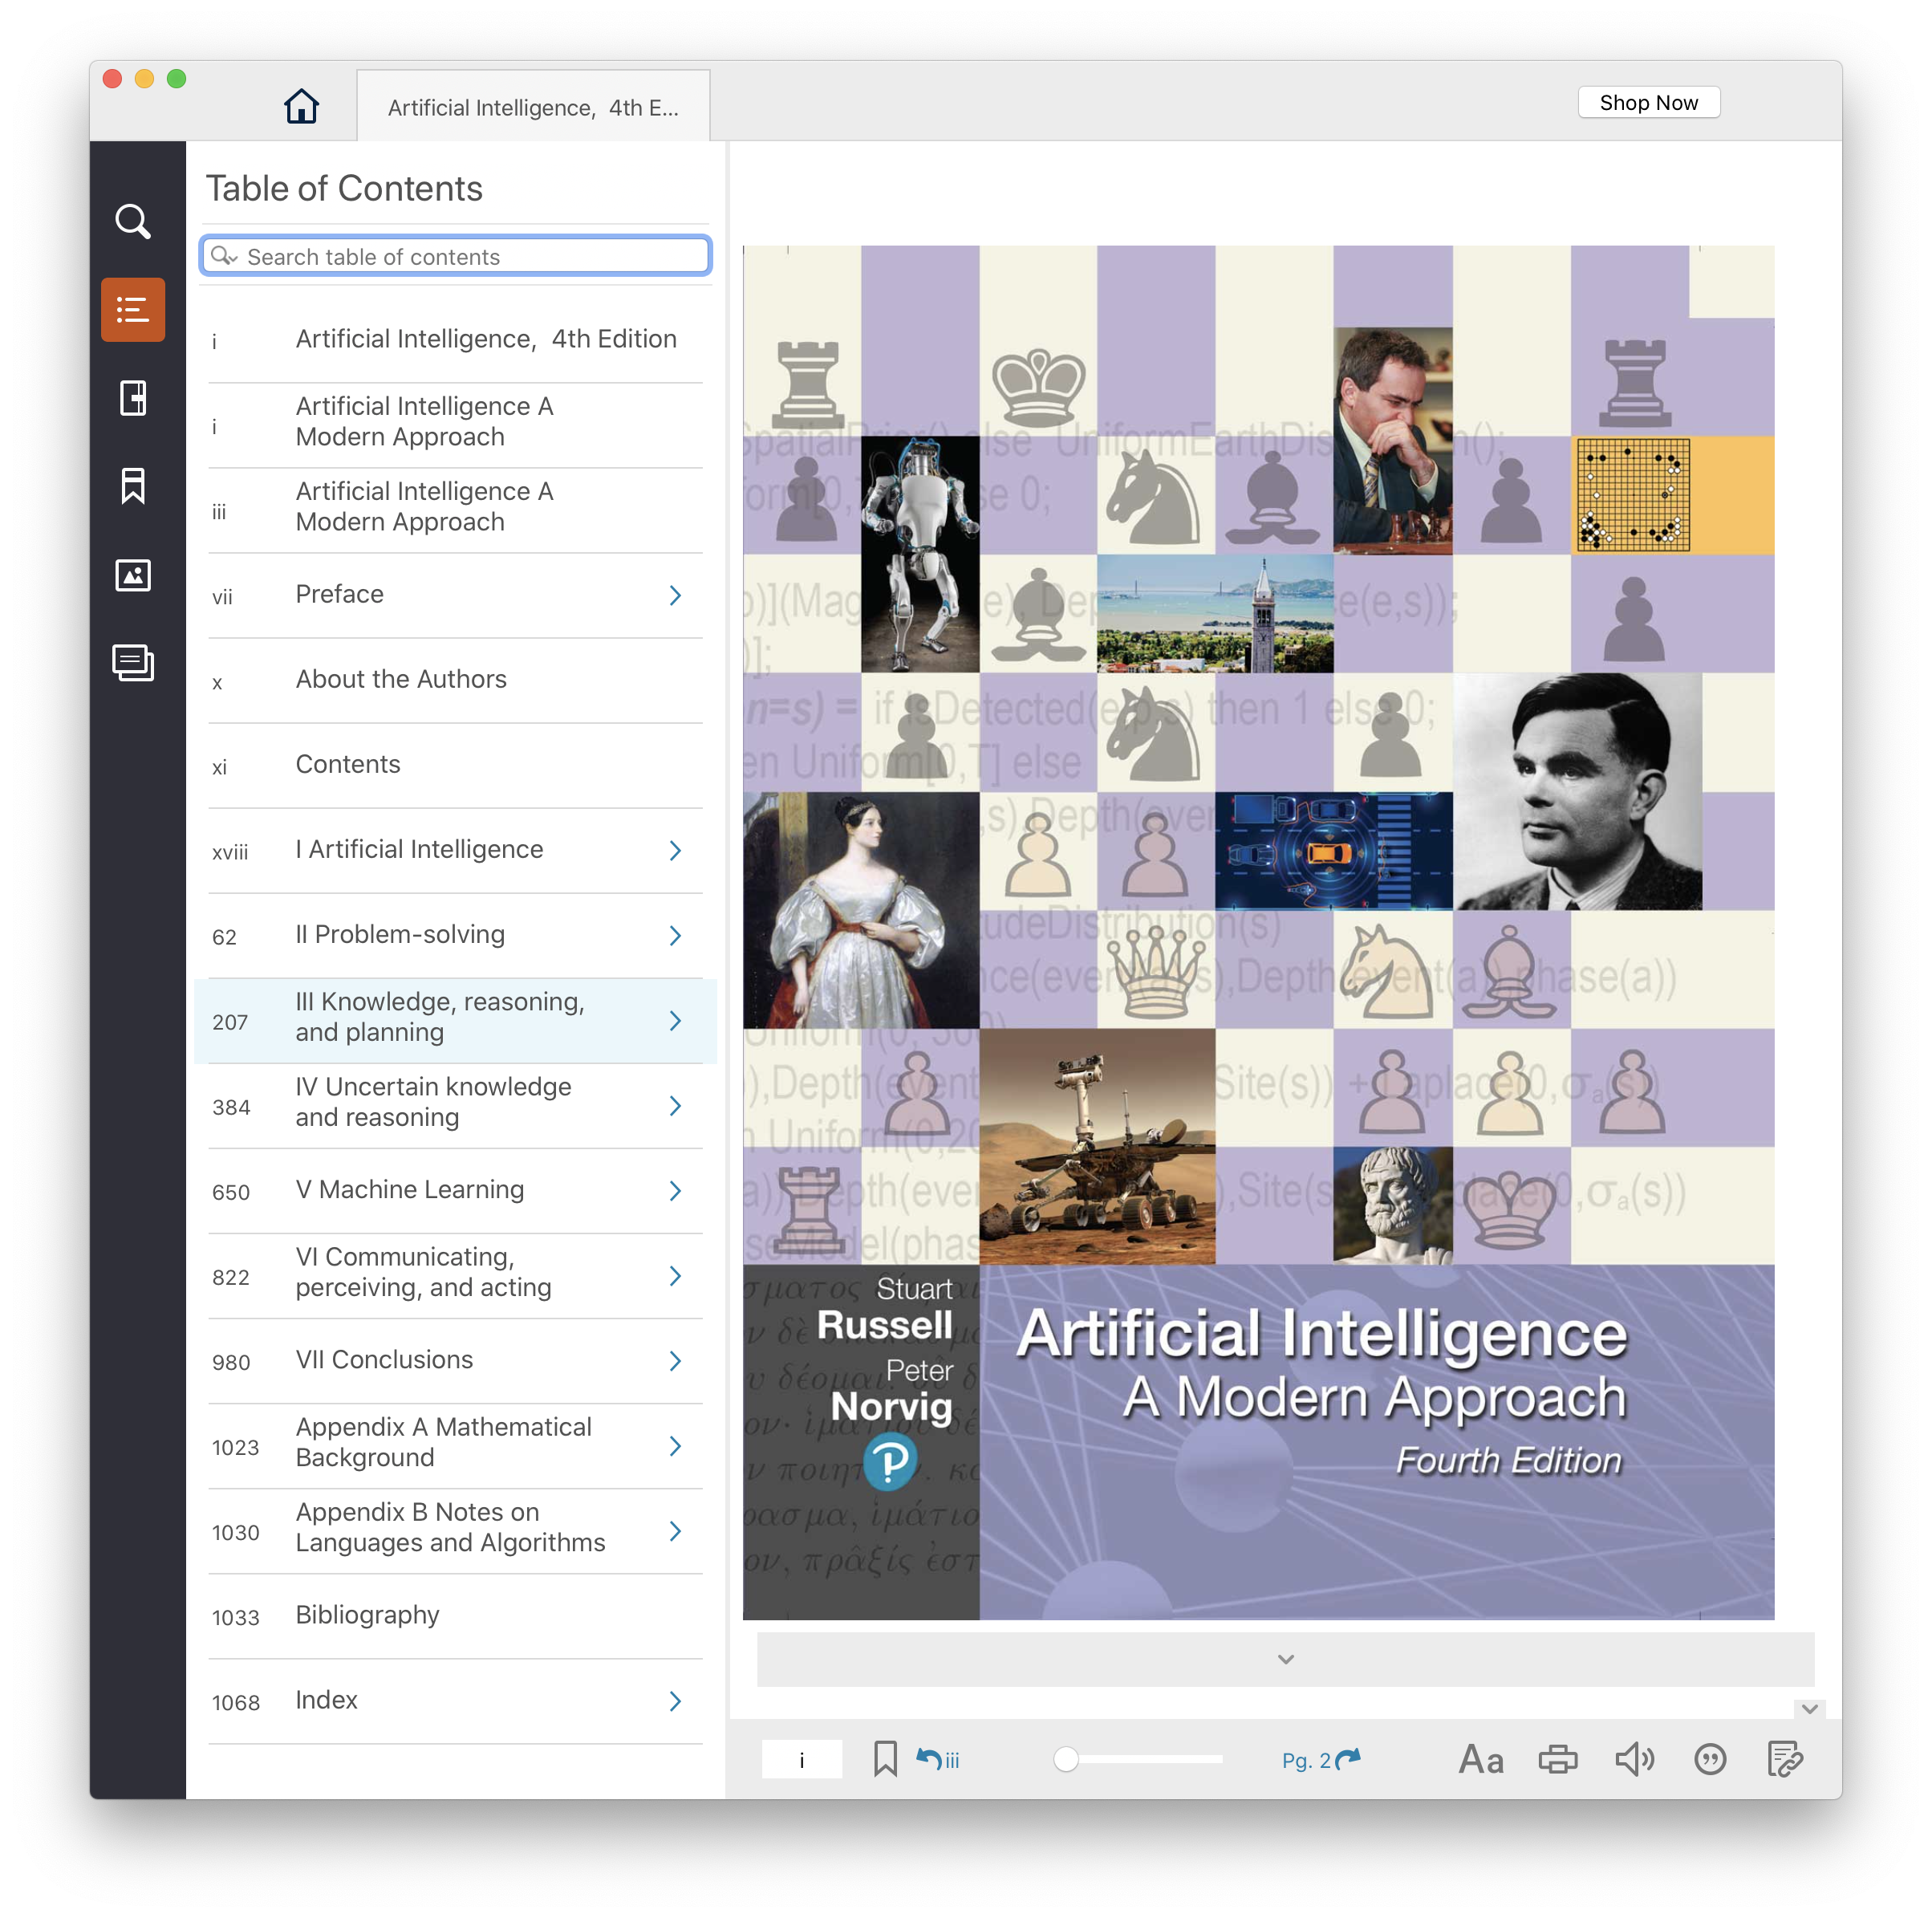
Text, CMI
4th edition of AIMA (2020) has lots of new material since the 2009 3rd edition
UMBC CMI program charges
$?? for a digital version, $160 on Amazon for hardcopy!
Access on Blackboard and/or download to computer/phone
May access copy on your system for many years
Opt-out of CMI via Blackboard

Slide 6

Course Website
www
Schedule, slides, assignments, readings, materials, syllabus here
https://umbc-cmsc471.github.io/spring2024/
https://campuswire.com/p/GC3E869BC
Course announcements, Q&A, discussion board here
No public code, follow posted rules and etiquette

Slide 7
Course Website
www
Schedule, slides, assignments, readings, materials, syllabus here
https://umbc-cmsc471.github.io/spring2024/
This Week
https://campuswire.com/p/GC3E869BC
Course announcements, Q&A, discussion board here
No public code, follow posted rules and etiquette

Slide 8

Course Website
www
Schedule, slides, assignments, readings, materials, syllabus here
https://umbc-cmsc471.github.io/spring2024/
https://www.gradescope.com/courses/724876
Assignment Submission
Rubrics Grading
Peer Grading

Slide 9
Course Website
www
Schedule, slides, assignments, readings, materials, syllabus here
https://umbc-cmsc471.github.io/spring2024/
This Week
https://www.gradescope.com/courses/724876
Assignment Submission
Rubrics Grading
Peer Grading

Slide 10
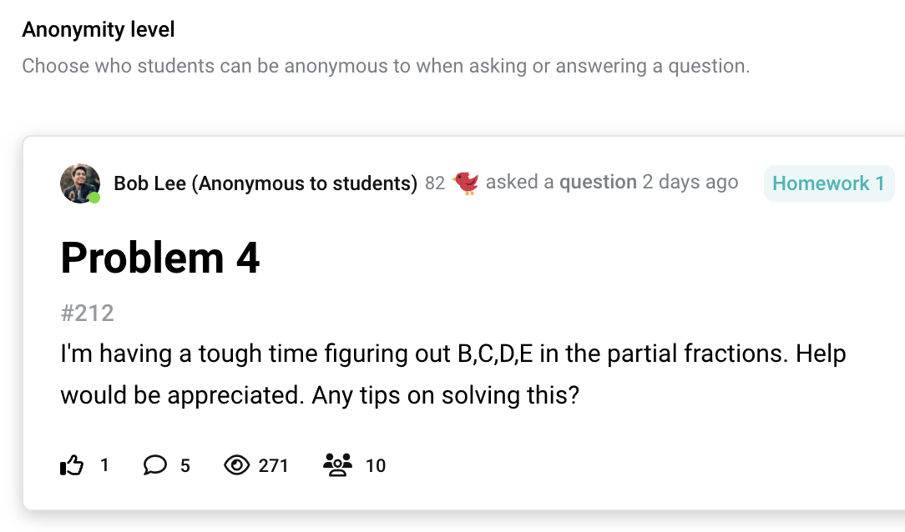
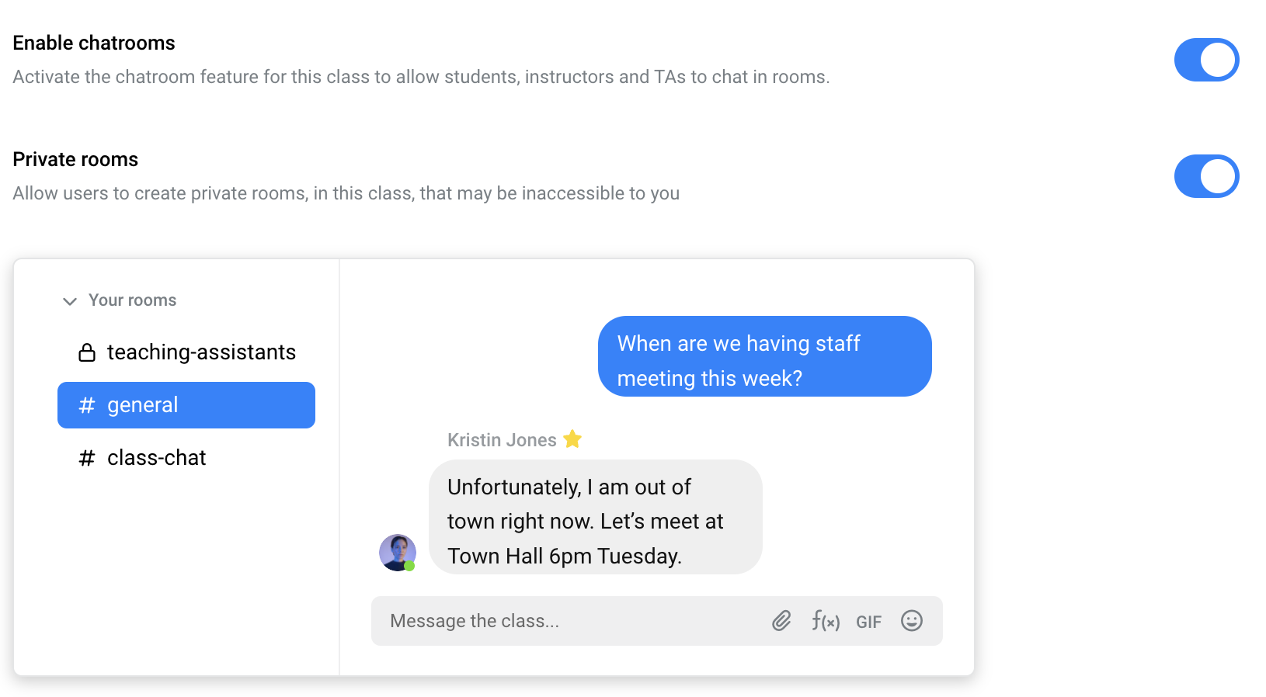

Slide 11
Course Website
www
Schedule, slides, assignments, readings, materials, syllabus here
https://umbc-cmsc471.github.io/fall2023-public/
This Week
https://campuswire.com/c/G38B2595B/feed
Course announcements, Q&A, discussion board here
No public code, follow posted rules and etiquette

Slide 12
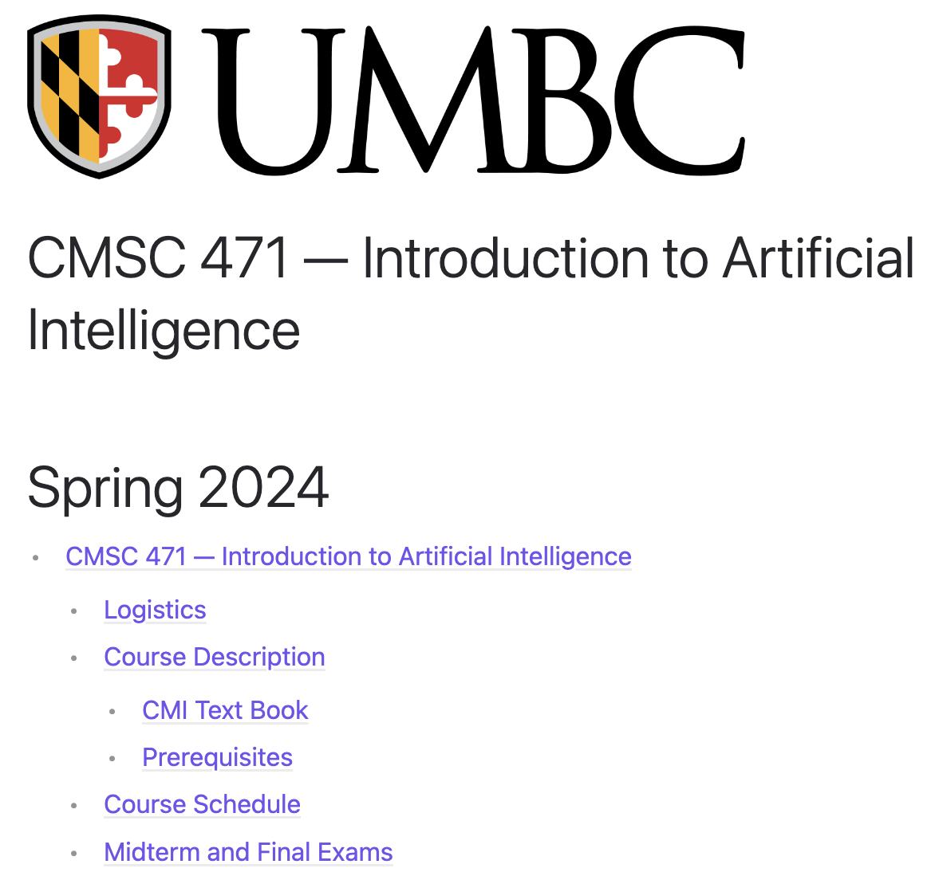
Course Syallabus (On the Website)

Slide 13
Reading Materials and Homework
Required Reading
Before Class
Notes?
Volunteers?
Released on Mon/Wed
Deadline on Mon/Wed

Slide 14
Academic Integrity
Super important: I take it very seriously
You are responsible for your (& your group’s) own work: if in doubt, ask!
Penalties could include 0 on the assignment, course failure, suspension, or expulsion (not exhaustive)

Slide 15
Academic Integrity
Generative AI
Prompts
Edits
Anything.AI
Paraphrase
Cite
Follow Etiquette

Slide 16
Course Evaluation
Components | Percentage
Quiz/ Homework | 15%
Assignments | 40%
Exams (Midterm + Final) | 40%
Course Engagement | 5%
Notes:
Midterm-final: 15-25

Slide 17
Course Evaluation
On Blackboard if we have them, mostly to motivate you to keep up with the reading and classes
Components | Percentage
Quiz (?) | 10%
Assignments | 45%
Exams (Midterm + Final) | 40%
Course Engagement | 5%
Notes:
Midterm-final: 15-25

Slide 18
Course Evaluation
Mostly to motivate you to keep up with the reading and classes
Components | Percentage
Quiz / Homework | 15%
Assignments | 40%
Exams (Midterm + Final) | 40%
Course Engagement | 5%
What is engagement?
Notes:
Midterm-final: 15-25

Slide 19


Slide 20




Slide 21
Final Grades
≥ | Letter
90 | A
80 | B
70 | C
60 | D
0 | F

Slide 22
Grades

Slide 23
Running the Assignments
A "standard" x86-64 Linux machine, like gl or the platform Google Colab gl
A passable amount of memory (2GB-4GB) [this is definitely the upper range]
Modern but not necessarily cutting edge software
If in doubt, ask first

Slide 24
Programming Languages for Assignments
Python, though individual assignments could vary
Remember: programming languages are tools. Don’t get too caught up in not “knowing” a language. This course will not be grading software engineering prowess.
Libraries: Assignment dependent. Generally OK, as long as you don’t use their implementation of what you need to implement
If in doubt, ask first
Notes:
E.g., C5 decision tree software, Weka Machine learning environments

Slide 25
Late Policy
Everyone has a budget of 10 late days, maximum 3 per assignment

Slide 26
Late Policy
Everyone has a budget of 10 late days, maximum 3 per assignment
If you have them left: assignments turned in after the deadline will be graded and recorded, no questions asked

Slide 27
Late Policy
Everyone has a budget of 10 late days, maximum 3 per assignment
If you have them left: assignments turned in after the deadline will be graded and recorded, no questions asked
If you don’t have any left: still turn assignments in. They could count in your favor in borderline cases

Slide 28
Late Policy
Everyone has a budget of 10 late days, maximum 3 per assignment
Use them as needed throughout the course
They’re meant for personal reasons and emergencies
Do not procrastinate

Slide 29
Late Policy
Everyone has a budget of 10 late days, maximum 3 per assignment
Contact me privately if an extended absence will occur
You must know how many you’ve used

Slide 30
Q: What is AI
(artificial intelligence)?

Slide 31
Sci-Fi AI?
Notes:
Who are these? C3PO, what does he do? Essentially google translate, (but with anxiety disorder!)
Smal guy? R2D2 – what does he do, yeah, not so sure
Things got darker: machines come back from the future – to kill us!
90’s : software is scary
Basic fear about what technology might do ?
What if we can’t even tell technology apart from ourselves?
OR maybe it’ll look really different and snarky
Some exceptions like wall-E, positive view of technology (but maybe not of us humans!)
But mostly a worry
White Vision
DC: Red Tornado
[not very worried myself, at least at present]

Slide 32
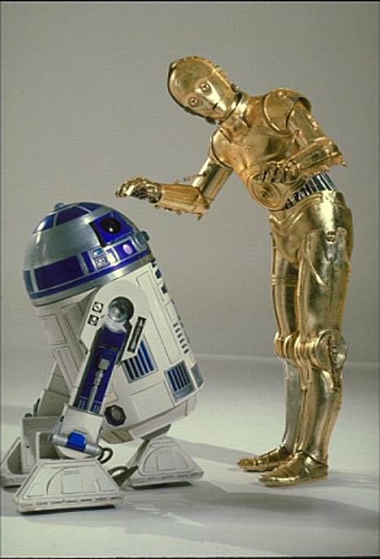
Sci-Fi AI?
Notes:
Who are these? C3PO, what does he do? Essentially google translate, (but with anxiety disorder!)
Smal guy? R2D2 – what does he do, yeah, not so sure
Things got darker: machines come back from the future – to kill us!
90’s : software is scary
Basic fear about what technology might do ?
What if we can’t even tell technology apart from ourselves?
OR maybe it’ll look really different and snarky
Some exceptions like wall-E, positive view of technology (but maybe not of us humans!)
But mostly a worry
White Vision
DC: Red Tornado
[not very worried myself, at least at present]

Slide 33
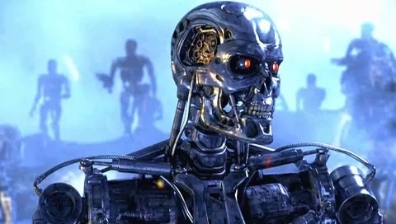
Sci-Fi AI?
Notes:
Who are these? C3PO, what does he do? Essentially google translate, (but with anxiety disorder!)
Smal guy? R2D2 – what does he do, yeah, not so sure
Things got darker: machines come back from the future – to kill us!
90’s : software is scary
Basic fear about what technology might do ?
What if we can’t even tell technology apart from ourselves?
OR maybe it’ll look really different and snarky
Some exceptions like wall-E, positive view of technology (but maybe not of us humans!)
But mostly a worry
White Vision
DC: Red Tornado
[not very worried myself, at least at present]

Slide 34

Sci-Fi AI?
Notes:
Who are these? C3PO, what does he do? Essentially google translate, (but with anxiety disorder!)
Smal guy? R2D2 – what does he do, yeah, not so sure
Things got darker: machines come back from the future – to kill us!
90’s : software is scary
Basic fear about what technology might do ?
What if we can’t even tell technology apart from ourselves?
OR maybe it’ll look really different and snarky
Some exceptions like wall-E, positive view of technology (but maybe not of us humans!)
But mostly a worry
White Vision
DC: Red Tornado
[not very worried myself, at least at present]

Slide 35
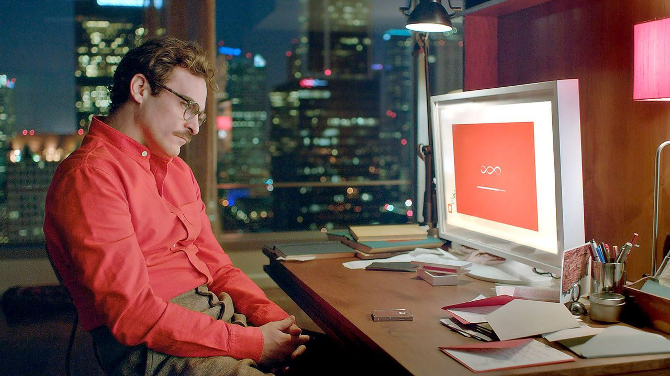
Sci-Fi AI?
Notes:
Who are these? C3PO, what does he do? Essentially google translate, (but with anxiety disorder!)
Smal guy? R2D2 – what does he do, yeah, not so sure
Things got darker: machines come back from the future – to kill us!
90’s : software is scary
Basic fear about what technology might do ?
What if we can’t even tell technology apart from ourselves?
OR maybe it’ll look really different and snarky
Some exceptions like wall-E, positive view of technology (but maybe not of us humans!)
But mostly a worry
White Vision
DC: Red Tornado
[not very worried myself, at least at present]

Slide 36
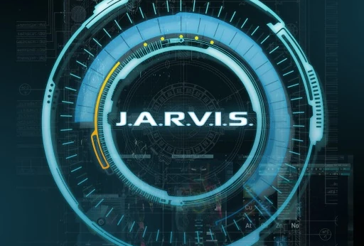

Sci-Fi AI?
Notes:
Who are these? C3PO, what does he do? Essentially google translate, (but with anxiety disorder!)
Smal guy? R2D2 – what does he do, yeah, not so sure
Things got darker: machines come back from the future – to kill us!
90’s : software is scary
Basic fear about what technology might do ?
What if we can’t even tell technology apart from ourselves?
OR maybe it’ll look really different and snarky
Some exceptions like wall-E, positive view of technology (but maybe not of us humans!)
But mostly a worry
White Vision
DC: Red Tornado
[not very worried myself, at least at present]

Slide 37
Real AI

Slide 38
Real AI

Slide 39
Real AI

Slide 40
Real AI

Slide 41
Real AI

Slide 42
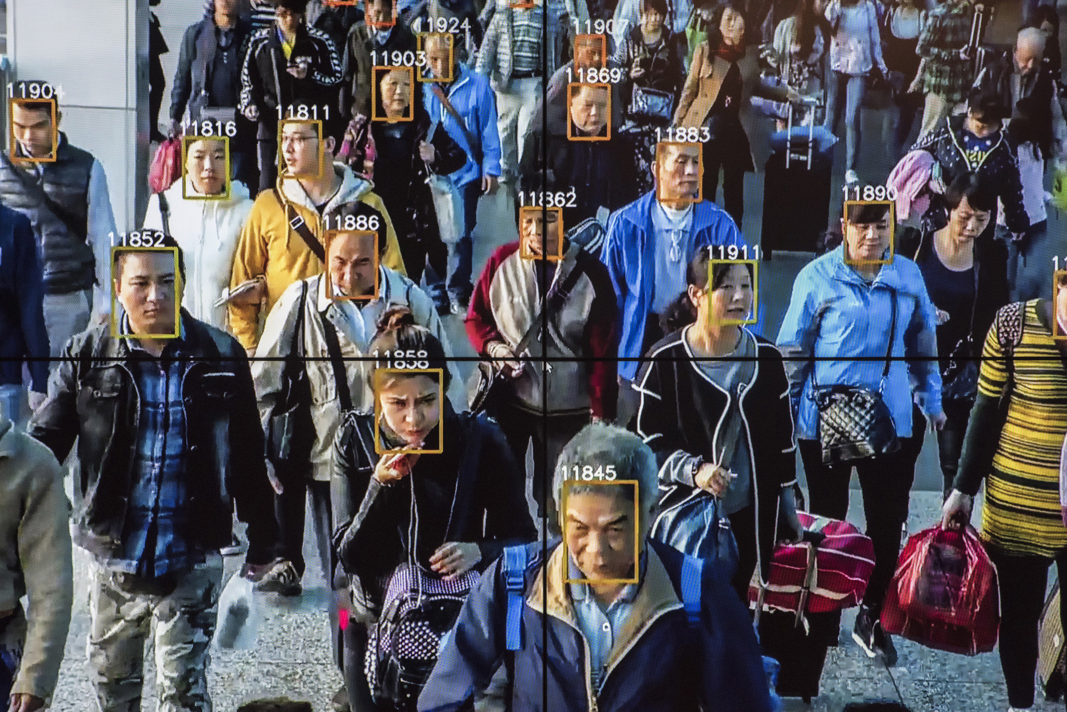
Real AI

Slide 43
Notes:
Robots help nurses in hospitals deliver stuff to different rooms

Slide 44
Notes:
Or drones that record cooll videos of us as we do outdoor activities
Or in my case,

Slide 45
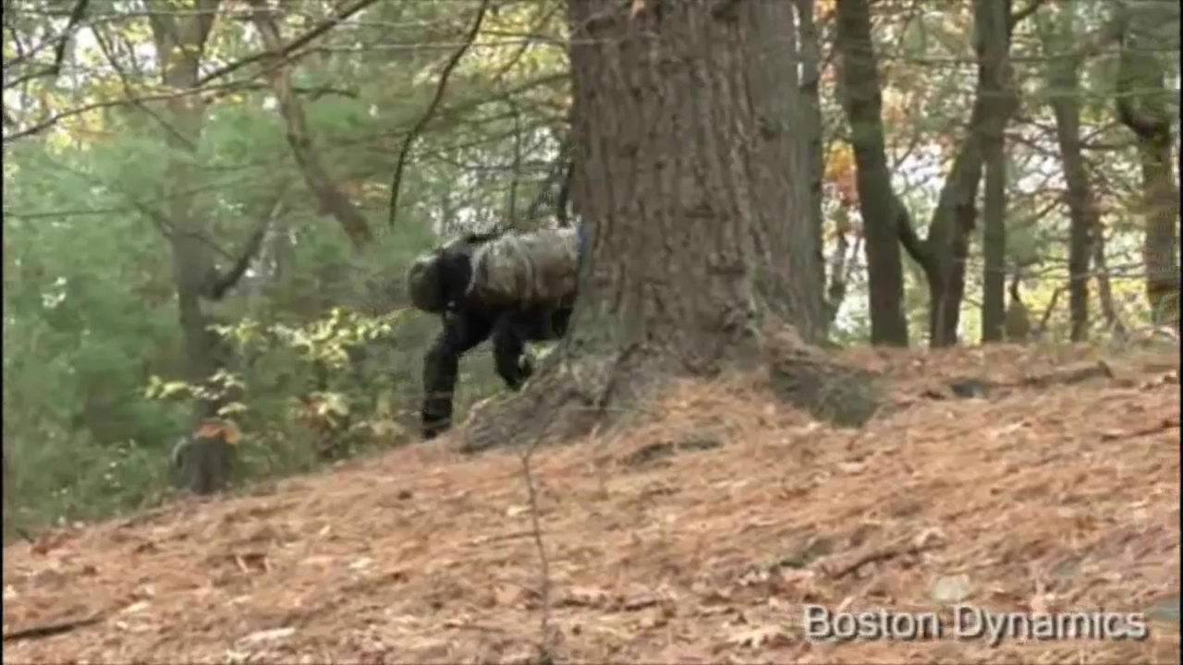

Slide 46
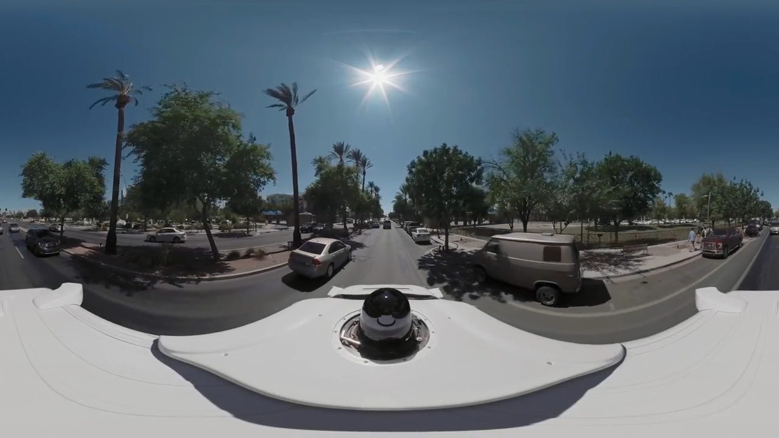

Slide 47
What is AI?
Q. What is artificial intelligence?
A. It is the science and engineering of making intelligent machines, especially intelligent computer programs. It is related to the similar task of using computers to understand human intelligence, but AI does not have to confine itself to methods that are biologically observable.
http://www-formal.stanford.edu/jmc/whatisai/
Notes:
Same in Berkley: science of making intelligent machines that do something, different schools of thoughts – thinking like people

Slide 48
Ok, so what is intelligence?
Q. Yes, but what is intelligence?
http://www-formal.stanford.edu/jmc/whatisai/
Notes:
Rational Decisions in Berkley Slide
ASK

Slide 49
Ok, so what is intelligence?
Q. Yes, but what is intelligence?
A. Intelligence is the computational part of the ability to achieve goals in the world. Varying kinds and degrees of intelligence occur in people, many animals and some machines
http://www-formal.stanford.edu/jmc/whatisai/
Notes:
Rational Decisions in Berkley Slide
ASK

Slide 50
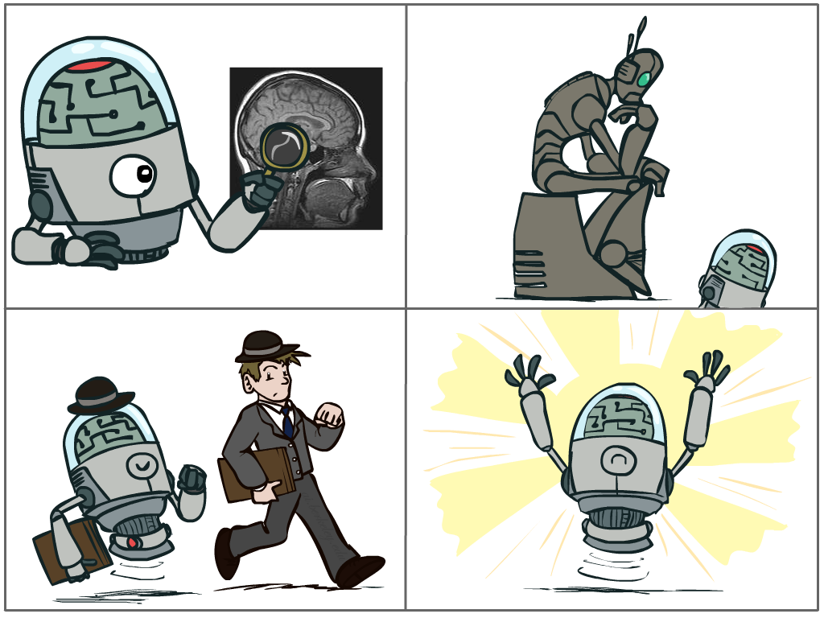
Possible Approaches
The science of making machines that:
Think like people
Think rationally
Act like people
Act rationally
Notes:
To summarize: there are different school of thoughts
Top left: Think like people --- cognitive science, neuroscience
Bottom left: act like people --- actually very early definition, dating back to Alan Turing --- Turing test; problem to do really well you start focusing on things like don’t answer too quickly what the square root of 1412 is, don’t spell too well, and make sure you have a favorite movie etc. So it wasn’t really leading us to build intelligence
Think rationally – long tradition dating back to Aristotle --- but not a winner, because difficult to encode how to think, and in the end it’s not about how you think, it’s about how you end up acting

Slide 51
Possible Approaches
The science of making machines that:
Think rationally
Act rationally
Notes:
TThink rationally – long tradition dating back to Aristotle --- but not a winner, because difficult to encode how to think, and in the end it’s not about how you think, it’s about how you end up acting modus ponens, rules of logical deduction, theorem proving 80’s.
Didn’t scale

Slide 52
Possible Approaches
The science of making machines that:
Think like people
Think rationally
Think rationally
Act like people
Act rationally
Notes:
Top left: Think like people --- (not so AI anymore) cognitive science, neuroscience,
Reverse engineer tech, but we don’t know what exactly goes in our brain
The outcome and action is more imp than the process, like chess playing systems

Slide 53
Possible Approaches
The science of making machines that:
Think like people
Think rationally
Act like people
Act rationally
Notes:
Bottom left: act like people --- actually very early definition, dating back to Alan Turing --- Turing test (two people talk/type, can you tell apart);
In turing test, problem to do really well you start focusing on things like don’t answer too quickly what the square root of 1412 is, don’t spell too well, and make sure you have a favorite movie etc. So it wasn’t really leading us to build intelligence
Think rationally – long tradition dating back to Aristotle --- but not a winner, because difficult to encode how to think, and in the end it’s not about how you think, it’s about how you end up acting

Slide 54
Possible Approaches
The science of making machines that:
Think like people
Think rationally
Act like people
Act rationally
Notes:
Modern approach to AI, build systems to act rationally
Logisist tradition -> optimization theory (stat and optimization)

Slide 55
Rational Decisions
We’ll use the term rational in a very specific, technical way:
Rational: maximally achieving pre-defined goals
Rationality only concerns what decisions are made
(not the thought process behind them)
Goals are expressed in terms of the utility of outcomes
Being rational means maximizing your expected utility
Notes:
Rational means in real life unemotional
Example of utilities. 10 for A, 1 for each Friday with friends
Rational : very specific and technical, goals can be anything, make dirty (dog)
In a siutuationk, take some action, affect world in possibly unknown ways, have utilities over the results, and u want to max it
A better title for this course would be:
Computational Rationality

Slide 56
Maximize Your Expected Utility

Slide 57
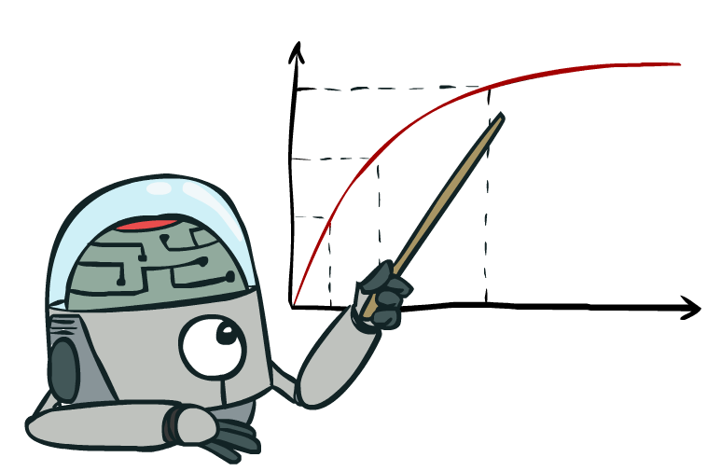
Maximize Your Expected Utility

Slide 58
Possible Approaches
Like humans
Well
Think
Act

Slide 59
Possible Approaches
Like humans
Well
Rational
agents
Think
GPS
Act
Heuristic
systems
Eliza

Slide 60
Possible Approaches
Like humans
Well
Rational
agents
Think
GPS
AI tends to work mostly in this area
Act
Heuristic
systems
Eliza
Notes:
Heuristic: rule of thumb, strategy, trick or simplification which drastically limits search for solutions in large problem spaces
Heuristics don’t guarantee optimal solutions or even any solution at all: all that can be said for a useful heuristic is that it offers solutions which are good enough most of the time
Think like human : GPS (General Problem Solver): Goal not just to produce humanlike behavior, but to produce a sequence of steps of reasoning process that was similar to those followed by a person
Turing test/ Eliza
Thinking rationally: Develop formal models of knowledge representation, reasoning, learning, memory, problem solving, that can be rendered in algorithms
Often an emphasis on a systems that are provably correct, and guarantee finding an optimal solution

Slide 61
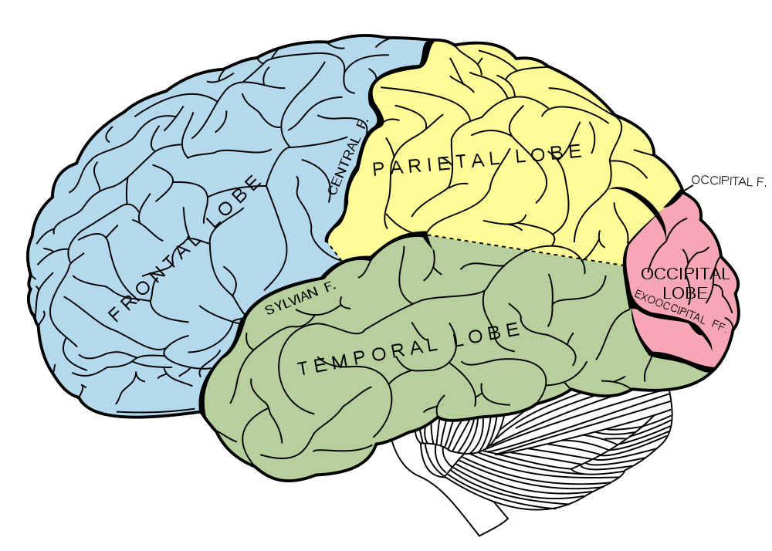
What About the Brain?
Brains (human minds) are very good at making rational decisions, but not perfect
Brains aren’t as modular as software, so hard to reverse engineer!
“Brains are to intelligence as wings are to flight”
Lessons learned from the brain: memory and simulation are key to decision making

Slide 62
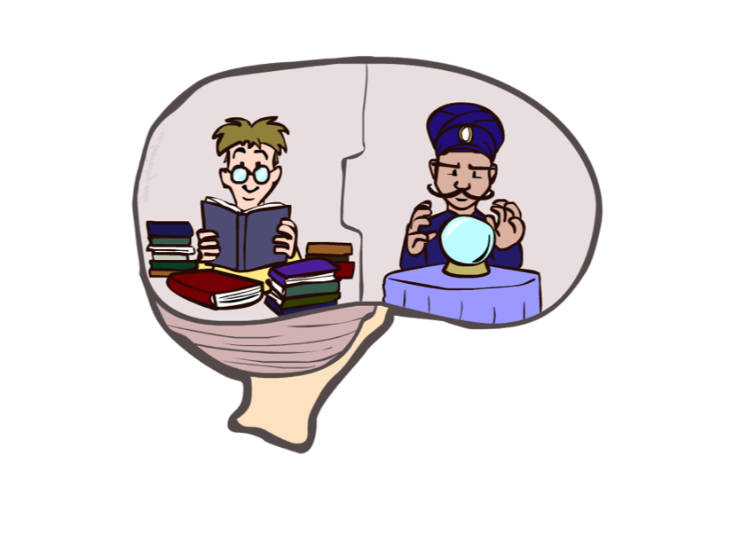
What About the Brain?
Brains (human minds) are very good at making rational decisions, but not perfect
Brains aren’t as modular as software, so hard to reverse engineer!
“Brains are to intelligence as wings are to flight”
Lessons learned from the brain: memory and simulation are key to decision making

Slide 63
What About the Brain?
Brains (human minds) are very good at making rational decisions, but not perfect
Brains aren’t as modular as software, so hard to reverse engineer!
“Brains are to intelligence as wings are to flight”
Lessons learned from the brain: memory (data) and simulation (computation) are key to decision making

Slide 64
Course Topics
Part 1: Intelligence from Computation
Fast search/planning
Constraint satisfaction (e.g. scheduling)
Adversarial and uncertain search (e.g. routing, navigation)
Part 2: Intelligence from Data
Probabilistic inference with Bayes’ nets (e.g. robot localization)
Decision theory
Machine learning (e.g. spam detection)
Throughout: Applications
Natural language, vision, robotics, games, etc.
Notes:
Second part comes from making good decisions on basis of data, how to act better based on experience

Slide 65

Big questions
Can machines think?
Must/should they think like humans do?
Can they learn from their experience?
Can they have common sense?
If so, how? If not, why not?
What does this say about human beings?
What does this say about the mind?

Slide 66
Why AI?
1 Engineering: get machines to do useful things
e.g., understand spoken natural language, recognize individual people in visual scenes, autonomous vehicles, better cybersecurity, …
2 Cognitive Science: model and understand how natural minds and mental phenomena work
e.g., visual perception, memory, learning, language, decision making, …
3 Philosophy: explore basic, interesting and important philosophical questions
e.g., mind-body problem, what’s consciousness, free will, …

Slide 67
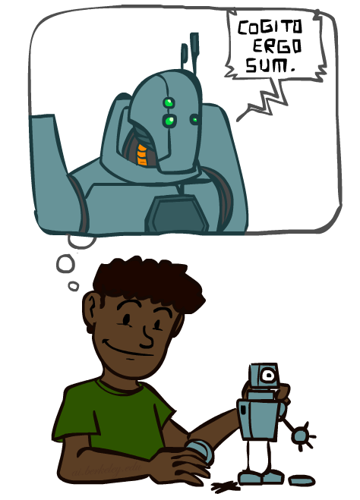
A (Short) History of AI
1940-1950: Early days
1943: McCulloch & Pitts: Boolean circuit model of brain
1950: Turing's “Computing Machinery and Intelligence”
1950—70: Excitement: Look, Ma, no hands!
1950s: Early AI programs, including Samuel's checkers program, Newell & Simon's Logic Theorist, Gelernter's Geometry Engine
1956: Dartmouth meeting: “Artificial Intelligence” adopted
1965: Robinson's complete algorithm for logical reasoning
1970—90: Knowledge-based approaches
1969—79: Early development of knowledge-based systems
1980—88: Expert systems industry booms
1988—93: Expert systems industry busts: “AI Winter”
1990—: Statistical approaches
Resurgence of probability, focus on uncertainty
General increase in technical depth
Agents and learning systems… “AI Spring”?
2000—: Where are we now?
Notes:
Million dollar computer with less computation than your phone
MT was

Slide 68
A (Short) History of AI
1940-1950: Early days
1943: McCulloch & Pitts: Boolean circuit model of brain
1950: Turing's “Computing Machinery and Intelligence”
1950—70: Excitement: Look, Ma, no hands!
1950s: Early AI programs, including Samuel's checkers program, Newell & Simon's Logic Theorist, Gelernter's Geometry Engine
1956: Dartmouth meeting: “Artificial Intelligence” adopted
1965: Robinson's complete algorithm for logical reasoning
1970—90: Knowledge-based approaches
1969—79: Early development of knowledge-based systems
1980—88: Expert systems industry booms
1988—93: Expert systems industry busts: “AI Winter”
1990—: Statistical approaches
Resurgence of probability, focus on uncertainty
General increase in technical depth
Agents and learning systems… “AI Spring”?
2000—: Where are we now?
Notes:
Million dollar computer with less computation than your phone
MT was

Slide 69
A (Short) History of AI
1940-1950: Early days
1943: McCulloch & Pitts: Boolean circuit model of brain
1950: Turing's “Computing Machinery and Intelligence”
1950—70: Excitement: Look, Ma, no hands!
1950s: Early AI programs, including Samuel's checkers program, Newell & Simon's Logic Theorist, Gelernter's Geometry Engine
1956: Dartmouth meeting: “Artificial Intelligence” adopted
1965: Robinson's complete algorithm for logical reasoning
1970—90: Knowledge-based approaches
1969—79: Early development of knowledge-based systems
1980—88: Expert systems industry booms
1988—93: Expert systems industry busts: “AI Winter”
1990—: Statistical approaches
Resurgence of probability, focus on uncertainty
General increase in technical depth
Agents and learning systems… “AI Spring”?
2000—: Where are we now?
Notes:
Million dollar computer with less computation than your phone
MT was

Slide 70
A (Short) History of AI
1940-1950: Early days
1943: McCulloch & Pitts: Boolean circuit model of brain
1950: Turing's “Computing Machinery and Intelligence”
1950—70: Excitement: Look, Ma, no hands!
1950s: Early AI programs, including Samuel's checkers program, Newell & Simon's Logic Theorist, Gelernter's Geometry Engine
1956: Dartmouth meeting: “Artificial Intelligence” adopted
1965: Robinson's complete algorithm for logical reasoning
1970—90: Knowledge-based approaches
1969—79: Early development of knowledge-based systems
1980—88: Expert systems industry booms
1988—93: Expert systems industry busts: “AI Winter”
1990—: Statistical approaches
Resurgence of probability, focus on uncertainty
General increase in technical depth
Agents and learning systems… “AI Spring”?
2000—: Where are we now?
Notes:
Million dollar computer with less computation than your phone
MT was

Slide 71
A (Short) History of AI
1940-1950: Early days
1943: McCulloch & Pitts: Boolean circuit model of brain
1950: Turing's “Computing Machinery and Intelligence”
1950—70: Excitement: Look, Ma, no hands!
1950s: Early AI programs, including Samuel's checkers program, Newell & Simon's Logic Theorist, Gelernter's Geometry Engine
1956: Dartmouth meeting: “Artificial Intelligence” adopted
1965: Robinson's complete algorithm for logical reasoning
1970—90: Knowledge-based approaches
1969—79: Early development of knowledge-based systems
1980—88: Expert systems industry booms
1988—93: Expert systems industry busts: “AI Winter”
1990—: Statistical approaches
Resurgence of probability, focus on uncertainty
General increase in technical depth
Agents and learning systems… “AI Spring”?
2000—: Where are we now?
Notes:
Million dollar computer with less computation than your phone

Slide 72
A (Short) History of AI
1940-1950: Early days
1943: McCulloch & Pitts: Boolean circuit model of brain
1950: Turing's “Computing Machinery and Intelligence”
1950—70: Excitement: Look, Ma, no hands!
1950s: Early AI programs, including Samuel's checkers program, Newell & Simon's Logic Theorist, Gelernter's Geometry Engine
1956: Dartmouth meeting: “Artificial Intelligence” adopted
1965: Robinson's complete algorithm for logical reasoning
1970—90: Knowledge-based approaches
1969—79: Early development of knowledge-based systems
1980—88: Expert systems industry booms
1988—93: Expert systems industry busts: “AI Winter”
1990—2012: Statistical approaches
Resurgence of probability, focus on uncertainty
General increase in technical depth
Agents and learning systems… “AI Spring”?
2012—: Where are we now?
Notes:
Million dollar computer with less computation than your phone
MT was

Slide 73
1956 Dartmouth Project
“We propose that a 2 month, 10 man study of artificial intelligence be carried out during the summer of 1956 at Dartmouth College in Hanover, New Hampshire. The study is to proceed on the basis of the conjecture that every aspect of learning or any other feature of intelligence can in principle be so precisely described that a machine can be made to simulate it. An attempt will be made to find how to make machines use language, form abstractions and concepts, solve kinds of problems now reserved for humans, and improve themselves. We think that a significant advance can be made in one or more of these problems if a carefully selected group of scientists work on it together for a summer.”
http://www-formal.stanford.edu/jmc/history/dartmouth/dartmouth.html

Slide 74
Turing Test¹
Three rooms: person, computer, interrogator
Interrogator communicates with others via a ‘teleprinter’
Interrogator tries to distinguish person and machine
Machine tries to fool interrogator into believing it is the person
Person acts naturally
If machine succeeds, we conclude it can think
¹ Turing, Alan (October 1950), "Computing Machinery and Intelligence", Mind. (236): 433–460.

Slide 75
Hot Topics Today
Neural networks again: Large Language Models, ChatGPT
Machine learning, data science
Exploiting big data
Autonomous vehicles, robotics
Text mining, spoken natural language understanding, Siri
Conversational AI, DuerOS
Computer vision, DALL-E
GPT-3 (OpenAI)
GPT-4 (OpenAI)
AlphaGo (Google DeepMind)
Watson (IBM)
Sophia (Hanson Robotics)
Tesla Autopilot (Tesla Inc)
Notes:
https://www.pycodemates.com/2023/02/top-5-worlds-most-advanced-ai-systems.html#google_vignette

Slide 76
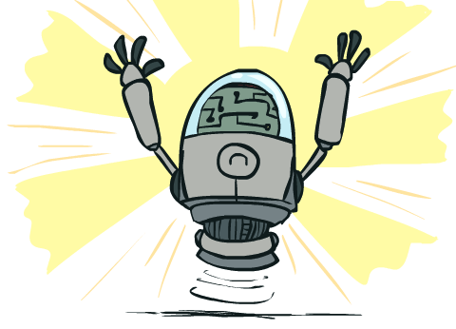
What Can AI Do?
Quiz: Which of the following can be done at present?
Play a decent game of Jeopardy?
Win against any human at chess?
Win against the best humans at Go?
Play a decent game of tennis?
Grab a particular cup and put it on a shelf?
Unload any dishwasher in any home?
Drive safely along the highway?
Drive safely along the streets of Pennsylvania?
Buy a week's worth of groceries on the web?
Buy a week's worth of groceries at H-mart?
Discover and prove a new mathematical theorem?
Perform a surgical operation?
Unload a know dishwasher in collaboration with a person?
Translate spoken Chinese into spoken English in real time?
Write an intentionally funny story?
Notes:
Lee sedol, but in 2023 again human defeated go (Berkeley student), human got the exploits of the system
Dishwasher – too much variation in environ.
Discover, but not prove
Winning art compettion: yes, but debate

Slide 77
What Can AI Do?
Quiz: Which of the following can be done at present?
Play a decent game of Jeopardy?
Win against any human at chess?
Win against the best humans at Go?
Play a decent game of tennis?
Grab a particular cup and put it on a shelf?
Unload any dishwasher in any home?
Drive safely along the highway?
Drive safely along the streets of Pennsylvania?
Buy a week's worth of groceries on the web?
Buy a week's worth of groceries at H-mart?
Discover and prove a new mathematical theorem?
Perform a surgical operation?
Unload a know dishwasher in collaboration with a person?
Translate spoken Chinese into spoken English in real time?
Write an intentionally funny story?
Notes:
Lee sedol, but in 2023 again human defeated go (Berkeley student), human got the exploits of the system
Dishwasher – too much variation in environ.
Discover, but not prove
Winning art compettion: yes, but debate

Slide 78
What Can AI Do?
Quiz: Which of the following can be done at present?
Play a decent game of Jeopardy?
Win against any human at chess?
Win against the best humans at Go?
Play a decent game of tennis?
Grab a particular cup and put it on a shelf?
Unload any dishwasher in any home?
Drive safely along the highway?
Drive safely along the streets of Pennsylvania?
Buy a week's worth of groceries on the web?
Buy a week's worth of groceries at H-mart?
Discover and prove a new mathematical theorem?
Perform a surgical operation?
Unload a know dishwasher in collaboration with a person?
Translate spoken Chinese into spoken English in real time?
Write an intentionally funny story?
Notes:
Lee sedol, but in 2023 again human defeated go (Berkeley student), human got the exploits of the system
Dishwasher – too much variation in environ.
Discover, but not prove
Winning art compettion: yes, but debate

Slide 79
What Can AI Do?
Quiz: Which of the following can be done at present?
Play a decent game of Jeopardy?
Win against any human at chess?
Win against the best humans at Go?
Play a decent game of tennis?
Grab a particular cup and put it on a shelf?
Unload any dishwasher in any home?
Drive safely along the highway?
Drive safely along the streets of Pennsylvania?
Buy a week's worth of groceries on the web?
Buy a week's worth of groceries at H-mart?
Discover and prove a new mathematical theorem?
Perform a surgical operation?
Unload a know dishwasher in collaboration with a person?
Translate spoken Chinese into spoken English in real time?
Write an intentionally funny story?
Notes:
Lee sedol, but in 2023 again human defeated go (Berkeley student), human got the exploits of the system
Dishwasher – too much variation in environ.
Discover, but not prove
Winning art compettion: yes, but debate

Slide 80
What Can AI Do?
Quiz: Which of the following can be done at present?
Play a decent game of Jeopardy?
Win against any human at chess?
Win against the best humans at Go?
Play a decent game of tennis?
Grab a particular cup and put it on a shelf?
Unload any dishwasher in any home?
Drive safely along the highway?
Drive safely along the streets of Pennsylvania?
Buy a week's worth of groceries on the web?
Buy a week's worth of groceries at H-mart?
Discover and prove a new mathematical theorem?
Perform a surgical operation?
Unload a know dishwasher in collaboration with a person?
Translate spoken Chinese into spoken English in real time?
Write an intentionally funny story?
Notes:
Lee sedol, but in 2023 again human defeated go (Berkeley student), human got the exploits of the system
Dishwasher – too much variation in environ.
Discover, but not prove
Winning art compettion: yes, but debate

Slide 81
What Can AI Do?
Quiz: Which of the following can be done at present?
Play a decent game of Jeopardy?
Win against any human at chess?
Win against the best humans at Go?
Play a decent game of tennis?
Grab a particular cup and put it on a shelf?
Unload any dishwasher in any home?
Drive safely along the highway?
Drive safely along the streets of Pennsylvania?
Buy a week's worth of groceries on the web?
Buy a week's worth of groceries at H-mart?
Discover and prove a new mathematical theorem?
Perform a surgical operation?
Unload a know dishwasher in collaboration with a person?
Translate spoken Chinese into spoken English in real time?
Write an intentionally funny story?
Notes:
Lee sedol, but in 2023 again human defeated go (Berkeley student), human got the exploits of the system
Dishwasher – too much variation in environ.
Discover, but not prove
Winning art compettion: yes, but debate

Slide 82
What Can AI Do?
Quiz: Which of the following can be done at present?
Play a decent game of Jeopardy?
Win against any human at chess?
Win against the best humans at Go?
Play a decent game of tennis?
Grab a particular cup and put it on a shelf?
Unload any dishwasher in any home?
Drive safely along the highway?
Drive safely along the streets of Pennsylvania?
Buy a week's worth of groceries on the web?
Buy a week's worth of groceries at H-mart?
Discover and prove a new mathematical theorem?
Perform a surgical operation?
Unload a know dishwasher in collaboration with a person?
Translate spoken Chinese into spoken English in real time?
Write an intentionally funny story?
Notes:
Lee sedol, but in 2023 again human defeated go (Berkeley student), human got the exploits of the system
Dishwasher – too much variation in environ.
Discover, but not prove
Winning art compettion: yes, but debate

Slide 83
What Can AI Do?
Quiz: Which of the following can be done at present?
Play a decent game of Jeopardy?
Win against any human at chess?
Win against the best humans at Go?
Play a decent game of tennis?
Grab a particular cup and put it on a shelf?
Unload any dishwasher in any home?
Drive safely along the highway?
Drive safely along the streets of Pennsylvania?
Buy a week's worth of groceries on the web?
Buy a week's worth of groceries at H-mart?
Discover and prove a new mathematical theorem?
Perform a surgical operation?
Unload a know dishwasher in collaboration with a person?
Translate spoken Chinese into spoken English in real time?
Write an intentionally funny story?
Notes:
Lee sedol, but in 2023 again human defeated go (Berkeley student), human got the exploits of the system
Dishwasher – too much variation in environ.
Discover, but not prove
Winning art compettion: yes, but debate

Slide 84
What Can AI Do?
Quiz: Which of the following can be done at present?
Play a decent game of Jeopardy?
Win against any human at chess?
Win against the best humans at Go?
Play a decent game of tennis?
Grab a particular cup and put it on a shelf?
Unload any dishwasher in any home?
Drive safely along the highway?
Drive safely along the streets of Pennsylvania?
Buy a week's worth of groceries on the web?
Buy a week's worth of groceries at H-mart?
Discover and prove a new mathematical theorem?
Perform a surgical operation?
Unload a know dishwasher in collaboration with a person?
Translate spoken Chinese into spoken English in real time?
Write an intentionally funny story?
Notes:
Lee sedol, but in 2023 again human defeated go (Berkeley student), human got the exploits of the system
Dishwasher – too much variation in environ.
Discover, but not prove
Winning art compettion: yes, but debate

Slide 85
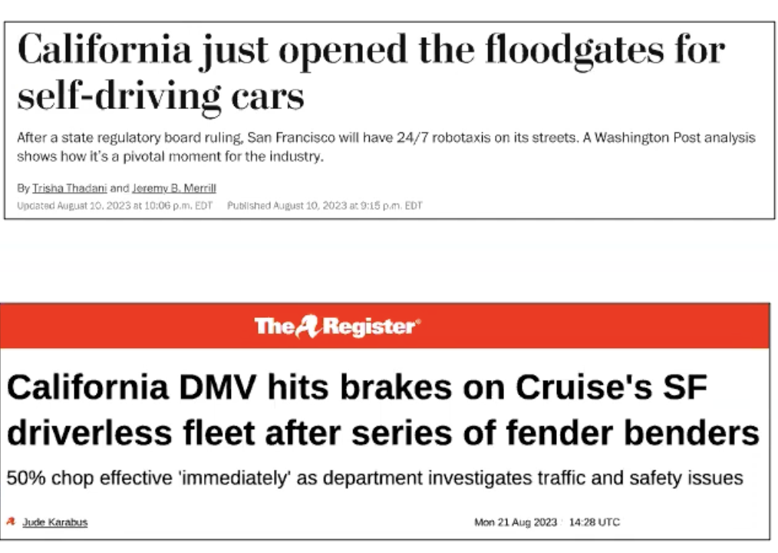
What Can AI Do?
Quiz: Which of the following can be done at present?
Play a decent game of Jeopardy?
Win against any human at chess?
Win against the best humans at Go?
Play a decent game of tennis?
Grab a particular cup and put it on a shelf?
Unload any dishwasher in any home?
Drive safely along the highway?
Drive safely along the streets of Pennsylvania?
Buy a week's worth of groceries on the web?
Buy a week's worth of groceries at H-mart?
Discover and prove a new mathematical theorem?
Perform a surgical operation?
Unload a know dishwasher in collaboration with a person?
Translate spoken Chinese into spoken English in real time?
Write an intentionally funny story?
Notes:
Lee sedol, but in 2023 again human defeated go (Berkeley student), human got the exploits of the system
Dishwasher – too much variation in environ.
Discover, but not prove
Winning art compettion: yes, but debate

Slide 86
What Can AI Do?
Quiz: Which of the following can be done at present?
Play a decent game of Jeopardy?
Win against any human at chess?
Win against the best humans at Go?
Play a decent game of tennis?
Grab a particular cup and put it on a shelf?
Unload any dishwasher in any home?
Drive safely along the highway?
Drive safely along the streets of Pennsylvania?
Buy a week's worth of groceries on the web?
Buy a week's worth of groceries at H-mart?
Discover and prove a new mathematical theorem?
Perform a surgical operation?
Unload a know dishwasher in collaboration with a person?
Translate spoken Chinese into spoken English in real time?
Write an intentionally funny story?
Notes:
Lee sedol, but in 2023 again human defeated go (Berkeley student), human got the exploits of the system
Dishwasher – too much variation in environ.
Discover, but not prove
Winning art compettion: yes, but debate

Slide 87
What Can AI Do?
Quiz: Which of the following can be done at present?
Play a decent game of Jeopardy?
Win against any human at chess?
Win against the best humans at Go?
Play a decent game of tennis?
Grab a particular cup and put it on a shelf?
Unload any dishwasher in any home?
Drive safely along the highway?
Drive safely along the streets of Pennsylvania?
Buy a week's worth of groceries on the web?
Buy a week's worth of groceries at H-mart?
Discover and prove a new mathematical theorem?
Perform a surgical operation?
Unload a know dishwasher in collaboration with a person?
Translate spoken Chinese into spoken English in real time?
Write an intentionally funny story?
Notes:
Lee sedol, but in 2023 again human defeated go (Berkeley student), human got the exploits of the system
Dishwasher – too much variation in environ.
Discover, but not prove
Winning art compettion: yes, but debate

Slide 88
What Can AI Do?
Quiz: Which of the following can be done at present?
Play a decent game of Jeopardy?
Win against any human at chess?
Win against the best humans at Go?
Play a decent game of tennis?
Grab a particular cup and put it on a shelf?
Unload any dishwasher in any home?
Drive safely along the highway?
Drive safely along the streets of Pennsylvania?
Buy a week's worth of groceries on the web?
Buy a week's worth of groceries at H-mart?
Discover and prove a new mathematical theorem?
Perform a surgical operation?
Unload a know dishwasher in collaboration with a person?
Translate spoken Chinese into spoken English in real time?
Write an intentionally funny story?
Notes:
Lee sedol, but in 2023 again human defeated go (Berkeley student), human got the exploits of the system
Dishwasher – too much variation in environ.
Discover, but not prove
Winning art compettion: yes, but debate

Slide 89
What Can AI Do?
Quiz: Which of the following can be done at present?
Play a decent game of Jeopardy?
Win against any human at chess?
Win against the best humans at Go?
Play a decent game of tennis?
Grab a particular cup and put it on a shelf?
Unload any dishwasher in any home?
Drive safely along the highway?
Drive safely along the streets of Pennsylvania?
Buy a week's worth of groceries on the web?
Buy a week's worth of groceries at H-mart?
Discover and prove a new mathematical theorem?
Perform a surgical operation?
Unload a know dishwasher in collaboration with a person?
Translate spoken Chinese into spoken English in real time?
Write an intentionally funny story?
Notes:
Lee sedol, but in 2023 again human defeated go (Berkeley student), human got the exploits of the system
Dishwasher – too much variation in environ.
Discover, but not prove
Winning art compettion: yes, but debate

Slide 90
What Can AI Do?
Quiz: Which of the following can be done at present?
Play a decent game of Jeopardy?
Win against any human at chess?
Win against the best humans at Go?
Play a decent game of tennis?
Grab a particular cup and put it on a shelf?
Unload any dishwasher in any home?
Drive safely along the highway?
Drive safely along the streets of Pennsylvania?
Buy a week's worth of groceries on the web?
Buy a week's worth of groceries at H-mart?
Discover and prove a new mathematical theorem?
Perform a surgical operation?
Unload a know dishwasher in collaboration with a person?
Translate spoken Chinese into spoken English in real time?
Write an intentionally funny story?
Notes:
Lee sedol, but in 2023 again human defeated go (Berkeley student), human got the exploits of the system
Dishwasher – too much variation in environ.
Discover, but not prove
Winning art compettion: yes, but debate

Slide 91
What Can AI Do?
Quiz: Which of the following can be done at present?
Play a decent game of Jeopardy?
Win against any human at chess?
Win against the best humans at Go?
Play a decent game of tennis?
Grab a particular cup and put it on a shelf?
Unload any dishwasher in any home?
Drive safely along the highway?
Drive safely along the streets of Pennsylvania?
Buy a week's worth of groceries on the web?
Buy a week's worth of groceries at H-mart?
Discover and prove a new mathematical theorem?
Perform a surgical operation?
Unload a know dishwasher in collaboration with a person?
Translate spoken Chinese into spoken English in real time?
Write an intentionally funny story?
Notes:
Lee sedol, but in 2023 again human defeated go (Berkeley student), human got the exploits of the system
Dishwasher – too much variation in environ.
Discover, but not prove
Winning art compettion: yes, but debate

Slide 92
What Can AI Do?
Quiz: Which of the following can be done at present?
Play a decent game of Jeopardy?
Win against any human at chess?
Win against the best humans at Go?
Play a decent game of tennis?
Grab a particular cup and put it on a shelf?
Unload any dishwasher in any home?
Drive safely along the highway?
Drive safely along the streets of Pennsylvania?
Buy a week's worth of groceries on the web?
Buy a week's worth of groceries at H-mart?
Discover and prove a new mathematical theorem?
Perform a surgical operation?
Unload a know dishwasher in collaboration with a person?
Translate spoken Chinese into spoken English in real time?
Write an intentionally funny story?
Notes:
Lee sedol, but in 2023 again human defeated go (Berkeley student), human got the exploits of the system
Dishwasher – too much variation in environ.
Discover, but not prove
Winning art compettion: yes, but debate

Slide 93
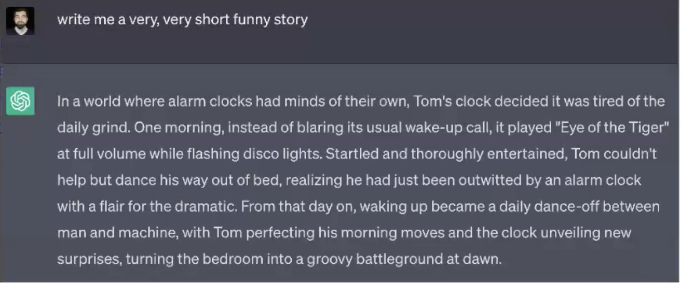
What Can AI Do?
Quiz: Which of the following can be done at present?
Play a decent game of Jeopardy?
Win against any human at chess?
Win against the best humans at Go?
Play a decent game of tennis?
Grab a particular cup and put it on a shelf?
Unload any dishwasher in any home?
Drive safely along the highway?
Drive safely along the streets of Pennsylvania?
Buy a week's worth of groceries on the web?
Buy a week's worth of groceries at H-mart?
Discover and prove a new mathematical theorem?
Perform a surgical operation?
Unload a know dishwasher in collaboration with a person?
Translate spoken Chinese into spoken English in real time?
Write an intentionally funny story?
Notes:
Lee sedol, but in 2023 again human defeated go (Berkeley student), human got the exploits of the system
Dishwasher – too much variation in environ.
Discover, but not prove
Winning art compettion: yes, but debate

Slide 94
Unintentionally Funny Stories
One day Joe Bear was hungry. He asked his friend
Irving Bird where some honey was. Irving told him
there was a beehive in the oak tree. Joe walked to
the oak tree. He ate the beehive. The End.
Henry Squirrel was thirsty. He walked over to the
river bank where his good friend Bill Bird was sitting.
Henry slipped and fell in the river. Gravity drowned.
The End.
Once upon a time there was a dishonest fox and a vain crow. One day the crow was sitting in his tree, holding a piece of cheese in his mouth. He noticed that he was holding the piece of cheese. He became hungry, and swallowed the cheese. The fox walked over to the crow. The End.
[Shank, Tale-Spin System, 1984]
Notes:
1 – physically wrong, shouldn’t eat beehive
2 – forgot that in drowning not the force is most important but the drownee
3 – not physically wrong, not wrong in a language way, but wrong in the sense that it’s not aware of what is relevant to communicate and what is not
Siri – is that progress?

Slide 95
Unintentionally Funny Stories
One day Joe Bear was hungry. He asked his friend
Irving Bird where some honey was. Irving told him
there was a beehive in the oak tree. Joe walked to
the oak tree. He ate the beehive. The End.
Henry Squirrel was thirsty. He walked over to the
river bank where his good friend Bill Bird was sitting.
Henry slipped and fell in the river. Gravity drowned.
The End.
Once upon a time there was a dishonest fox and a vain crow. One day the crow was sitting in his tree, holding a piece of cheese in his mouth. He noticed that he was holding the piece of cheese. He became hungry, and swallowed the cheese. The fox walked over to the crow. The End.
[Shank, Tale-Spin System, 1984]
Notes:
1 – physically wrong, shouldn’t eat beehive
2 – forgot that in drowning not the force is most important but the drownee
3 – not physically wrong, not wrong in a language way, but wrong in the sense that it’s not aware of what is relevant to communicate and what is not
Siri – is that progress?

Slide 96
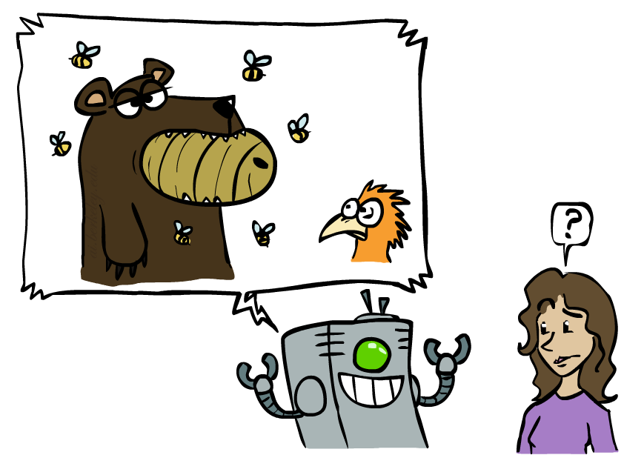
Unintentionally Funny Stories
One day Joe Bear was hungry. He asked his friend
Irving Bird where some honey was. Irving told him
there was a beehive in the oak tree. Joe walked to
the oak tree. He ate the beehive. The End.
Henry Squirrel was thirsty. He walked over to the
river bank where his good friend Bill Bird was sitting.
Henry slipped and fell in the river. Gravity drowned.
The End.
Once upon a time there was a dishonest fox and a vain crow. One day the crow was sitting in his tree, holding a piece of cheese in his mouth. He noticed that he was holding the piece of cheese. He became hungry, and swallowed the cheese. The fox walked over to the crow. The End.
[Shank, Tale-Spin System, 1984]
Notes:
1 – physically wrong, shouldn’t eat beehive
2 – forgot that in drowning not the force is most important but the drownee
3 – not physically wrong, not wrong in a language way, but wrong in the sense that it’s not aware of what is relevant to communicate and what is not
Siri – is that progress?

Slide 97
Unintentionally Funny Stories
One day Joe Bear was hungry. He asked his friend
Irving Bird where some honey was. Irving told him
there was a beehive in the oak tree. Joe walked to
the oak tree. He ate the beehive. The End.
Henry Squirrel was thirsty. He walked over to the
river bank where his good friend Bill Bird was sitting.
Henry slipped and fell in the river. Gravity drowned.
The End.
Once upon a time there was a dishonest fox and a vain crow. One day the crow was sitting in his tree, holding a piece of cheese in his mouth. He noticed that he was holding the piece of cheese. He became hungry, and swallowed the cheese. The fox walked over to the crow. The End.
[Shank, Tale-Spin System, 1984]
Notes:
1 – physically wrong, shouldn’t eat beehive
2 – forgot that in drowning not the force is most important but the drownee
3 – not physically wrong, not wrong in a language way, but wrong in the sense that it’s not aware of what is relevant to communicate and what is not
Siri – is that progress?

Slide 98
Unintentionally Funny Stories
One day Joe Bear was hungry. He asked his friend
Irving Bird where some honey was. Irving told him
there was a beehive in the oak tree. Joe walked to
the oak tree. He ate the beehive. The End.
Henry Squirrel was thirsty. He walked over to the
river bank where his good friend Bill Bird was sitting.
Henry slipped and fell in the river. Gravity drowned.
The End.
Once upon a time there was a dishonest fox and a vain crow. One day the crow was sitting in his tree, holding a piece of cheese in his mouth. He noticed that he was holding the piece of cheese. He became hungry, and swallowed the cheese. The fox walked over to the crow. The End.
[Shank, Tale-Spin System, 1984]
Notes:
1 – physically wrong, shouldn’t eat beehive
2 – forgot that in drowning not the force is most important but the drownee
3 – not physically wrong, not wrong in a language way, but wrong in the sense that it’s not aware of what is relevant to communicate and what is not
Siri – is that progress?

Slide 99
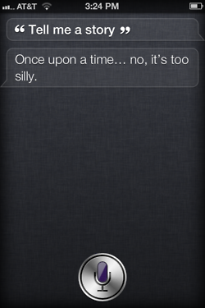
Unintentionally Funny Stories
One day Joe Bear was hungry. He asked his friend
Irving Bird where some honey was. Irving told him
there was a beehive in the oak tree. Joe walked to
the oak tree. He ate the beehive. The End.
Henry Squirrel was thirsty. He walked over to the
river bank where his good friend Bill Bird was sitting.
Henry slipped and fell in the river. Gravity drowned.
The End.
Once upon a time there was a dishonest fox and a vain crow. One day the crow was sitting in his tree, holding a piece of cheese in his mouth. He noticed that he was holding the piece of cheese. He became hungry, and swallowed the cheese. The fox walked over to the crow. The End.
[Shank, Tale-Spin System, 1984]
Notes:
1 – physically wrong, shouldn’t eat beehive
2 – forgot that in drowning not the force is most important but the drownee
3 – not physically wrong, not wrong in a language way, but wrong in the sense that it’s not aware of what is relevant to communicate and what is not
Siri – is that progress?

Slide 100
Unintentionally Funny Stories
One day Joe Bear was hungry. He asked his friend
Irving Bird where some honey was. Irving told him
there was a beehive in the oak tree. Joe walked to
the oak tree. He ate the beehive. The End.
Henry Squirrel was thirsty. He walked over to the
river bank where his good friend Bill Bird was sitting.
Henry slipped and fell in the river. Gravity drowned.
The End.
Once upon a time there was a dishonest fox and a vain crow. One day the crow was sitting in his tree, holding a piece of cheese in his mouth. He noticed that he was holding the piece of cheese. He became hungry, and swallowed the cheese. The fox walked over to the crow. The End.
[Shank, Tale-Spin System, 1984]
Notes:
1 – physically wrong, shouldn’t eat beehive
2 – forgot that in drowning not the force is most important but the drownee
3 – not physically wrong, not wrong in a language way, but wrong in the sense that it’s not aware of what is relevant to communicate and what is not
Siri – is that progress?

Slide 101
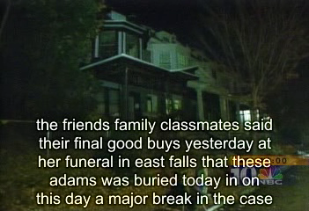
Natural Language
Speech technologies (e.g. Siri)
Automatic speech recognition (ASR)
Text-to-speech synthesis (TTS)
Dialog systems
Language processing technologies
Question answering
Machine translation
Web search
Text classification, spam filtering, etc…

Slide 102
Natural Language
Speech technologies (e.g. Siri)
Automatic speech recognition (ASR)
Text-to-speech synthesis (TTS)
Dialog systems
Language processing technologies
Question answering
Machine translation
Web search
Text classification, spam filtering, etc…

Slide 103
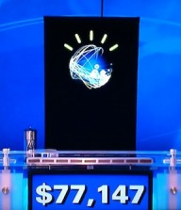
Natural Language
Speech technologies (e.g. Siri)
Automatic speech recognition (ASR)
Text-to-speech synthesis (TTS)
Dialog systems
Language processing technologies
Question answering
Machine translation
Web search
Text classification, spam filtering, etc…

Slide 104
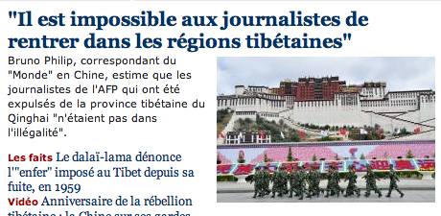
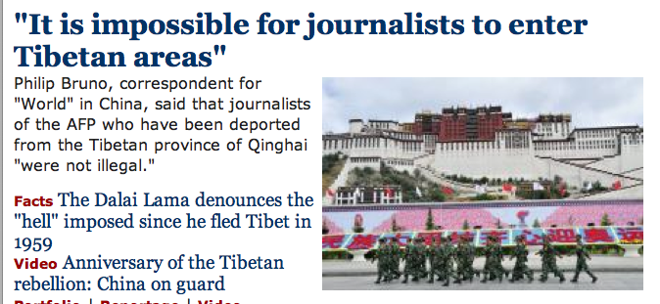
Natural Language
Speech technologies (e.g. Siri)
Automatic speech recognition (ASR)
Text-to-speech synthesis (TTS)
Dialog systems
Language processing technologies
Question answering
Machine translation
Web search
Text classification, spam filtering, etc…

Slide 105
Natural Language
Speech technologies (e.g. Siri)
Automatic speech recognition (ASR)
Text-to-speech synthesis (TTS)
Dialog systems
Language processing technologies
Question answering
Machine translation
Web search
Text classification, spam filtering, etc…

Slide 106
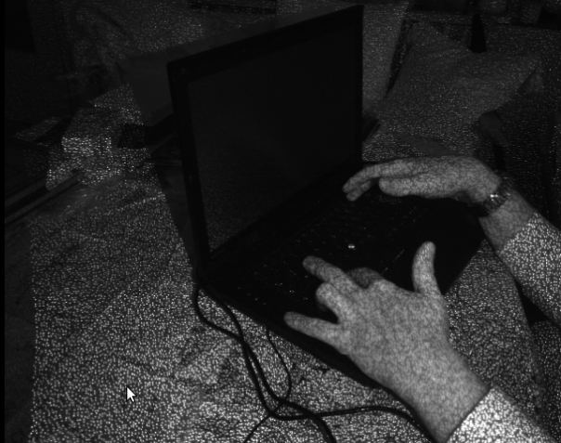
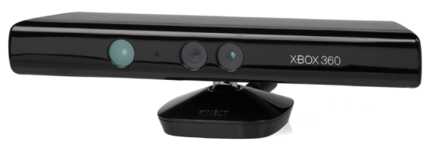
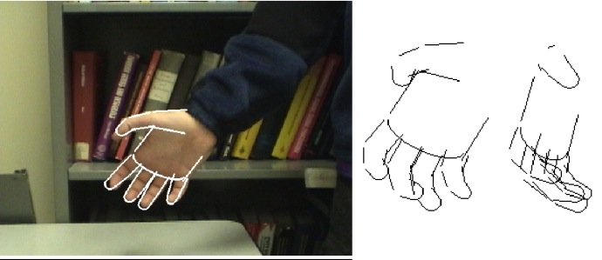

Vision (Perception)
Object and face recognition
Scene segmentation
Image classification
Demo: YOLO obj-detect
Images from Erik Sudderth (left), wikipedia (right)
Notes:
Pioxels – info/decision
3d understanding

Slide 107
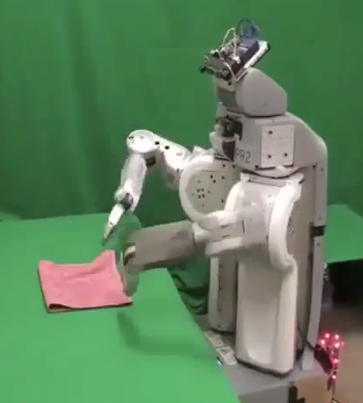
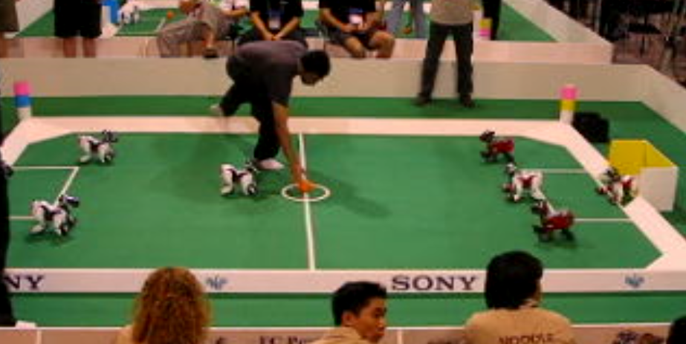
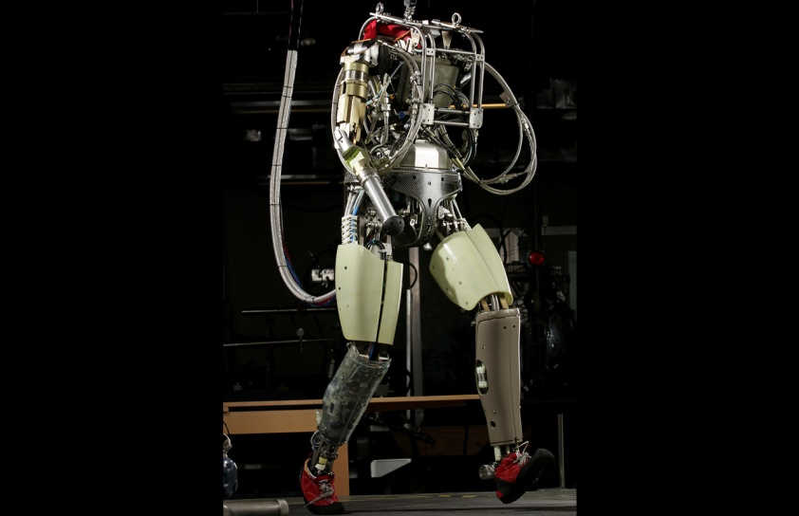
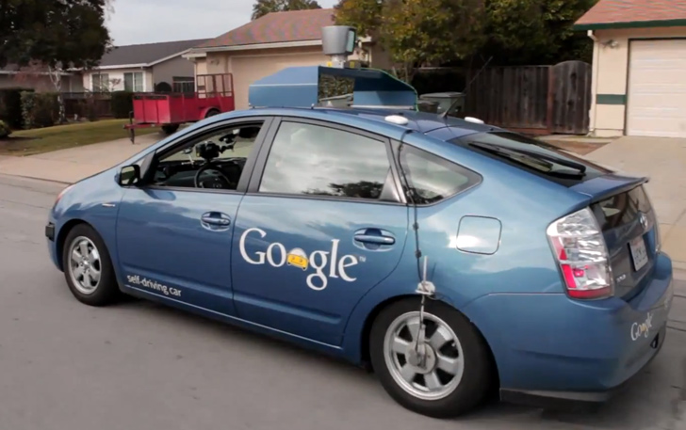
Robotics
Demo 1: ROBOTICS – soccer.avi
Demo 4: ROBOTICS – laundry.avi
Demo 5: ROBOTICS – petman.avi
Demo 3: ROBOTICS – gcar.avi
Robotics
Part mech. eng.
Part AI
Reality much
harder than
simulations!
Technologies
Vehicles
Rescue
Soccer!
Lots of automation…
In this class:
We ignore mechanical aspects
Methods for planning
Methods for control
Images from UC Berkeley, Boston Dynamics, RoboCup, Google

Slide 108
Logic
Logical systems
Theorem provers
NASA fault diagnosis
Question answering
Methods:
Deduction systems
Constraint satisfaction
Satisfiability solvers (huge advances!)
Image from Bart Selman

Slide 109
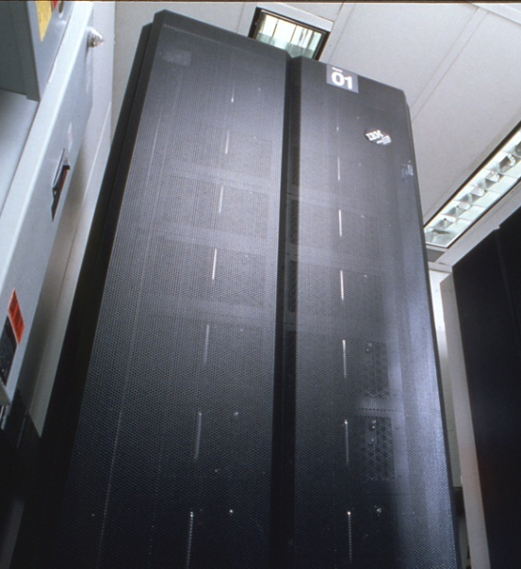
Game Playing
Classic Moment: May, '97: Deep Blue vs. Kasparov
First match won against world champion
“Intelligent creative” play
200 million board positions per second
Humans understood 99.9 of Deep Blue's moves
Can do about the same now with a PC cluster
Open question:
How does human cognition deal with the
search space explosion of chess?
Or: how can humans compete with computers at all??
1996: Kasparov Beats Deep Blue
“I could feel --- I could smell --- a new kind of intelligence across the table.”
1997: Deep Blue Beats Kasparov
“Deep Blue hasn't proven anything.”
Huge game-playing advances recently, e.g. in Go!
In March 2016, it beat Lee Sedol in a five-game match, the first time a computer Go program has beaten a 9-dan professional without handicap
Text from Bart Selman, image from IBM’s Deep Blue pages
Notes:
Yeah, Kasparov comment probably says more about humans than about computers

Slide 110
Game Playing
Classic Moment: May, '97: Deep Blue vs. Kasparov
First match won against world champion
“Intelligent creative” play
200 million board positions per second
Humans understood 99.9 of Deep Blue's moves
Can do about the same now with a PC cluster
Open question:
How does human cognition deal with the
search space explosion of chess?
Or: how can humans compete with computers at all??
1996: Kasparov Beats Deep Blue
“I could feel --- I could smell --- a new kind of intelligence across the table.”
1997: Deep Blue Beats Kasparov
“Deep Blue hasn't proven anything.”
Huge game-playing advances recently, e.g. in Go!
In March 2016, it beat Lee Sedol in a five-game match, the first time a computer Go program has beaten a 9-dan professional without handicap
Text from Bart Selman, image from IBM’s Deep Blue pages
Notes:
Yeah, Kasparov comment probably says more about humans than about computers

Slide 111
Game Playing
Classic Moment: May, '97: Deep Blue vs. Kasparov
First match won against world champion
“Intelligent creative” play
200 million board positions per second
Humans understood 99.9 of Deep Blue's moves
Can do about the same now with a PC cluster
Open question:
How does human cognition deal with the
search space explosion of chess?
Or: how can humans compete with computers at all??
1996: Kasparov Beats Deep Blue
“I could feel --- I could smell --- a new kind of intelligence across the table.”
1997: Deep Blue Beats Kasparov
“Deep Blue hasn't proven anything.”
Huge game-playing advances recently, e.g. in Go!
In March 2016, it beat Lee Sedol in a five-game match, the first time a computer Go program has beaten a 9-dan professional without handicap
Text from Bart Selman, image from IBM’s Deep Blue pages
Notes:
Yeah, Kasparov comment probably says more about humans than about computers

Slide 112
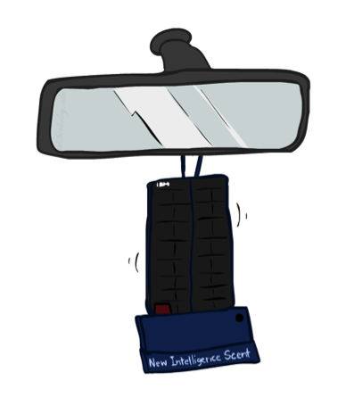
Game Playing
Classic Moment: May, '97: Deep Blue vs. Kasparov
First match won against world champion
“Intelligent creative” play
200 million board positions per second
Humans understood 99.9 of Deep Blue's moves
Can do about the same now with a PC cluster
Open question:
How does human cognition deal with the
search space explosion of chess?
Or: how can humans compete with computers at all??
1996: Kasparov Beats Deep Blue
“I could feel --- I could smell --- a new kind of intelligence across the table.”
1997: Deep Blue Beats Kasparov
“Deep Blue hasn't proven anything.”
Huge game-playing advances recently, e.g. in Go!
In March 2016, it beat Lee Sedol in a five-game match, the first time a computer Go program has beaten a 9-dan professional without handicap
Text from Bart Selman, image from IBM’s Deep Blue pages
Notes:
Yeah, Kasparov comment probably says more about humans than about computers

Slide 113
Game Playing
Classic Moment: May, '97: Deep Blue vs. Kasparov
First match won against world champion
“Intelligent creative” play
200 million board positions per second
Humans understood 99.9 of Deep Blue's moves
Can do about the same now with a PC cluster
Open question:
How does human cognition deal with the
search space explosion of chess?
Or: how can humans compete with computers at all??
1996: Kasparov Beats Deep Blue
“I could feel --- I could smell --- a new kind of intelligence across the table.”
1997: Deep Blue Beats Kasparov
“Deep Blue hasn't proven anything.”
Huge game-playing advances recently, e.g. in Go!
In March 2016, it beat Lee Sedol in a five-game match, the first time a computer Go program has beaten a 9-dan professional without handicap
Text from Bart Selman, image from IBM’s Deep Blue pages
Notes:
Yeah, Kasparov comment probably says more about humans than about computers

Slide 114
Game Playing
Classic Moment: May, '97: Deep Blue vs. Kasparov
First match won against world champion
“Intelligent creative” play
200 million board positions per second
Humans understood 99.9 of Deep Blue's moves
Can do about the same now with a PC cluster
Open question:
How does human cognition deal with the
search space explosion of chess?
Or: how can humans compete with computers at all??
1996: Kasparov Beats Deep Blue
“I could feel --- I could smell --- a new kind of intelligence across the table.”
1997: Deep Blue Beats Kasparov
“Deep Blue hasn't proven anything.”
Huge game-playing advances recently, e.g. in Go!
In March 2016, it beat Lee Sedol in a five-game match, the first time a computer Go program has beaten a 9-dan professional without handicap
Text from Bart Selman, image from IBM’s Deep Blue pages
Notes:
Yeah, Kasparov comment probably says more about humans than about computers

Slide 115
Game Playing
Classic Moment: May, '97: Deep Blue vs. Kasparov
First match won against world champion
“Intelligent creative” play
200 million board positions per second
Humans understood 99.9 of Deep Blue's moves
Can do about the same now with a PC cluster
Open question:
How does human cognition deal with the
search space explosion of chess?
Or: how can humans compete with computers at all??
1996: Kasparov Beats Deep Blue
“I could feel --- I could smell --- a new kind of intelligence across the table.”
1997: Deep Blue Beats Kasparov
“Deep Blue hasn't proven anything.”
Huge game-playing advances recently, e.g. in Go!
In March 2016, it beat Lee Sedol in a five-game match, the first time a computer Go program has beaten a 9-dan professional without handicap
Text from Bart Selman, image from IBM’s Deep Blue pages
Notes:
Yeah, Kasparov comment probably says more about humans than about computers

Slide 116

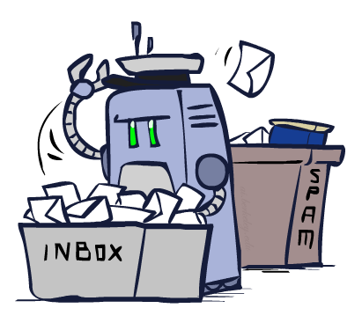
Decision Making
Applied AI involves many kinds of automation
Scheduling, e.g. airline routing, military
Route planning, e.g. Google maps
Medical diagnosis
Web search engines
Spam classifiers
Automated help desks
Fraud detection
Product recommendations
… Lots more!
Notes:
All applications can be thought of as decision making or useful sub-components of decision making

Slide 117
Challenges
Constraints of physical world
Variability of real world
Digital world?

Slide 118
What can’t AI systems do yet? (Fully? Completely?)
Understand natural language robustly (e.g., read and understand articles in a newspaper)
Surf the web and find interesting knowledge
Interpret an arbitrary visual scene
Learn a natural language
Play Go well
Construct plans in dynamic real-time domains
Refocus attention in complex environments
Perform life-long learning
Notes:
https://www.theverge.com/2016/3/14/11219258/google-deepmind-alphago-go-challenge-ai-future

Slide 119
What can’t AI systems do yet? (Fully? Completely?)
Understand natural language robustly (e.g., read and understand articles in a newspaper)
Surf the web and find interesting knowledge
Interpret an arbitrary visual scene
Learn a natural language
Play Go well
Construct plans in dynamic real-time domains
Refocus attention in complex environments
Perform life-long learning
Exhibit true autonomy and intelligence!
Notes:
https://www.theverge.com/2016/3/14/11219258/google-deepmind-alphago-go-challenge-ai-future

Slide 120
What can’t AI systems do yet? (Fully? Completely?)
Understand natural language robustly (e.g., read and understand articles in a newspaper)
Surf the web and find interesting knowledge
Interpret an arbitrary visual scene
Learn a natural language
Play Go well
Construct plans in dynamic real-time domains
Refocus attention in complex environments
Perform life-long learning
Exhibit true autonomy and intelligence!
Notes:
https://www.theverge.com/2016/3/14/11219258/google-deepmind-alphago-go-challenge-ai-future

Slide 121
A Partial, Incomplete View of AI, as a diagram of keywords*
NLP
AI
Reinforcement Learning
Deep Learning
Planning & Constraint Satisfaction
ML
CV
Robotics
*ask 10 people, get 11+ opinions
Notes:
http://www-formal.stanford.edu/jmc/whatisai/node2.html

Slide 122
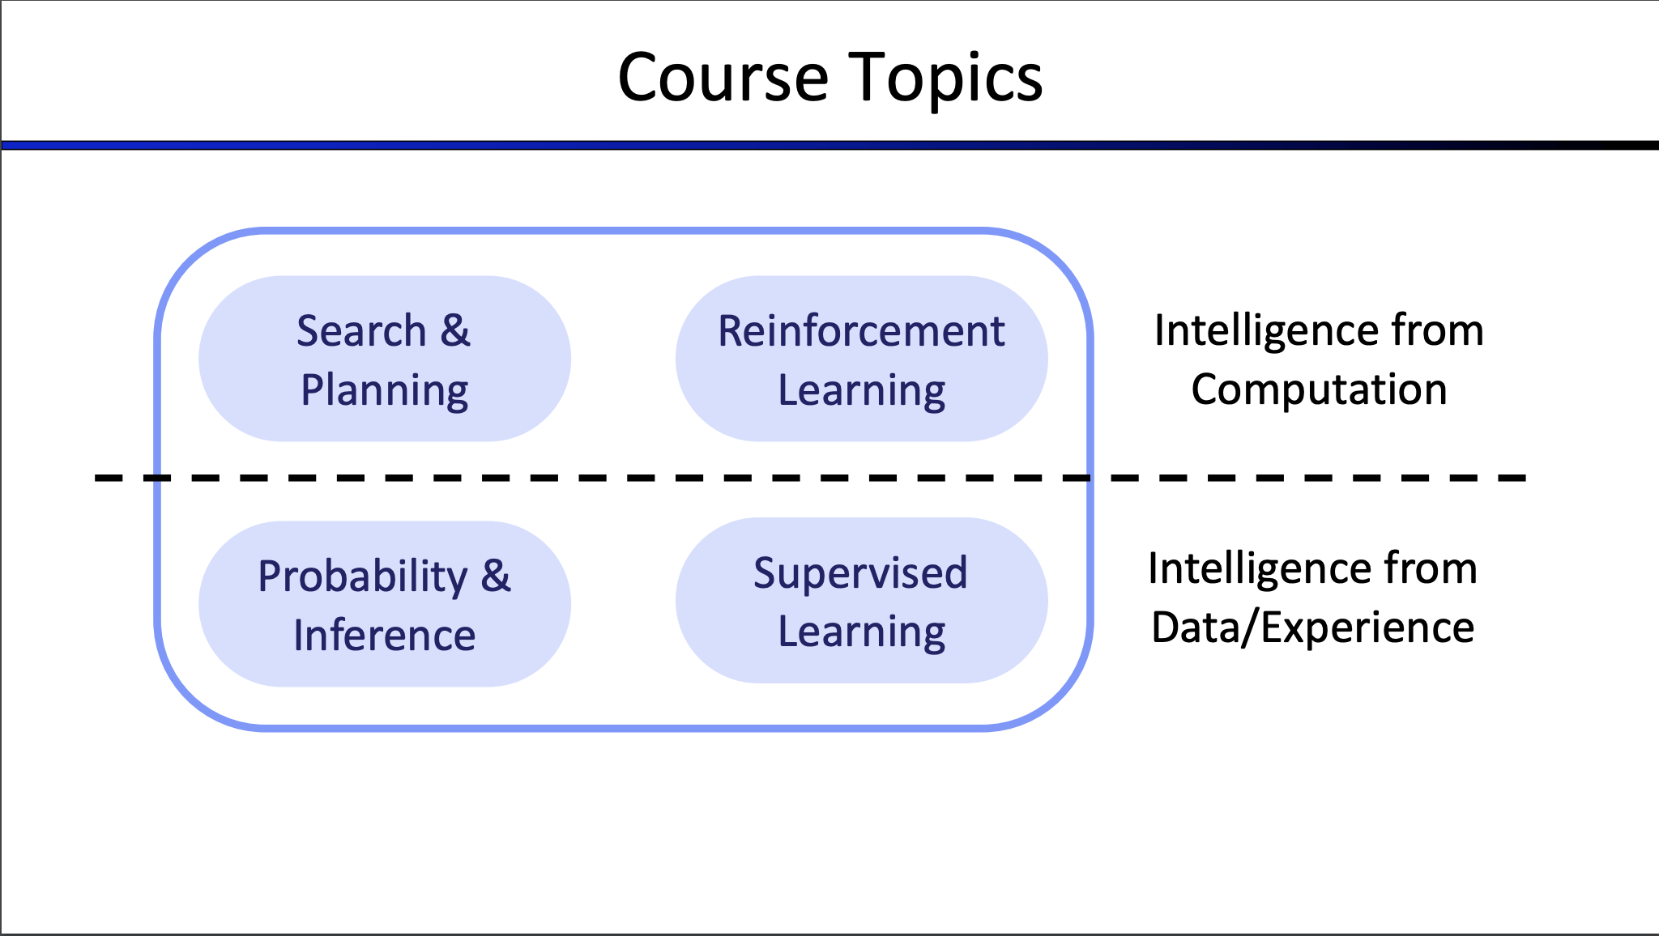
Notes:
How can I find a sequence of best decisions for a particular situation?
How can I find rules (policy) to make best decisions for any situation?
How can I make sense of uncertainty in the world?
How can I learn a model of the world from data?

Slide 123
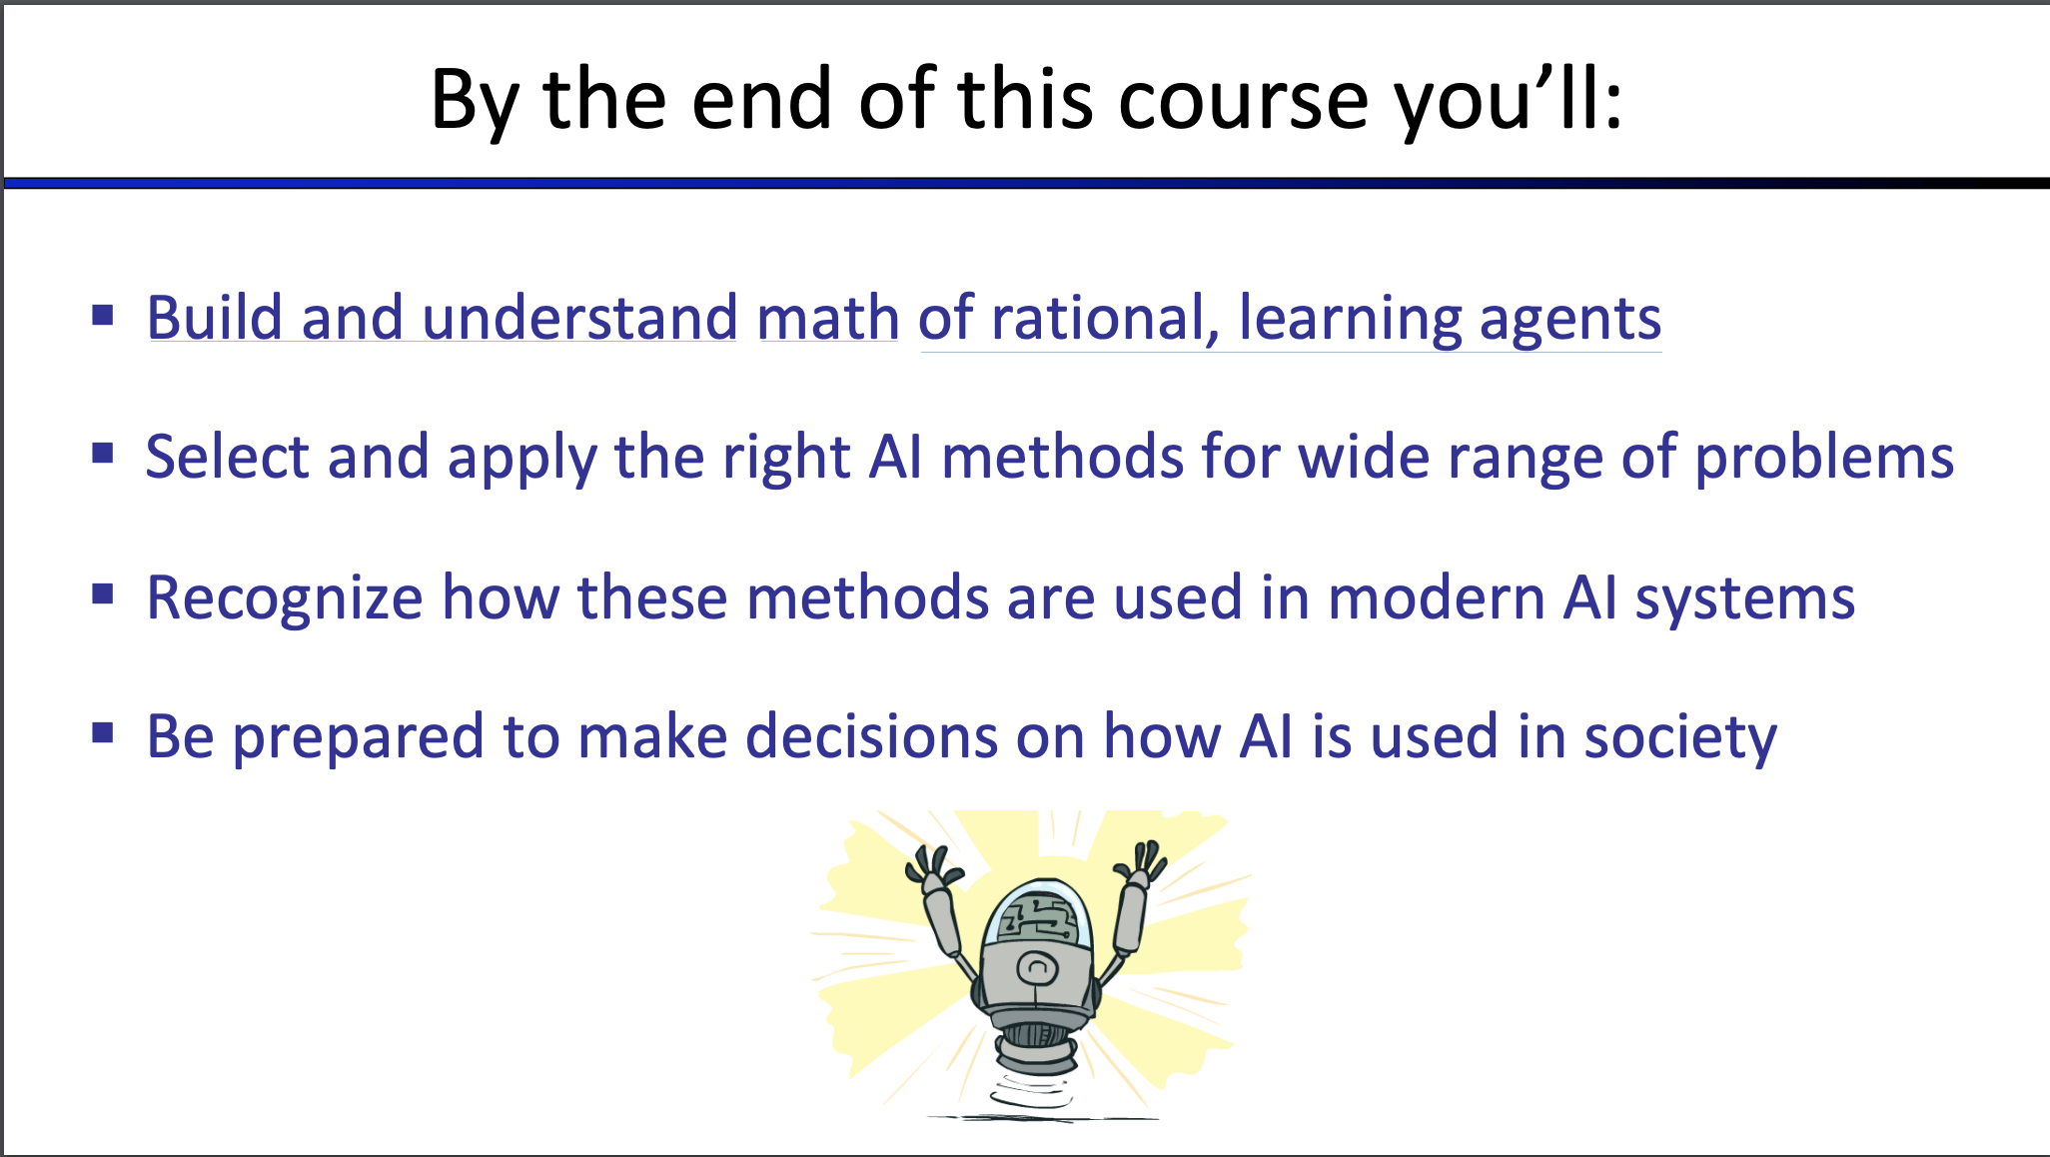

Slide 124
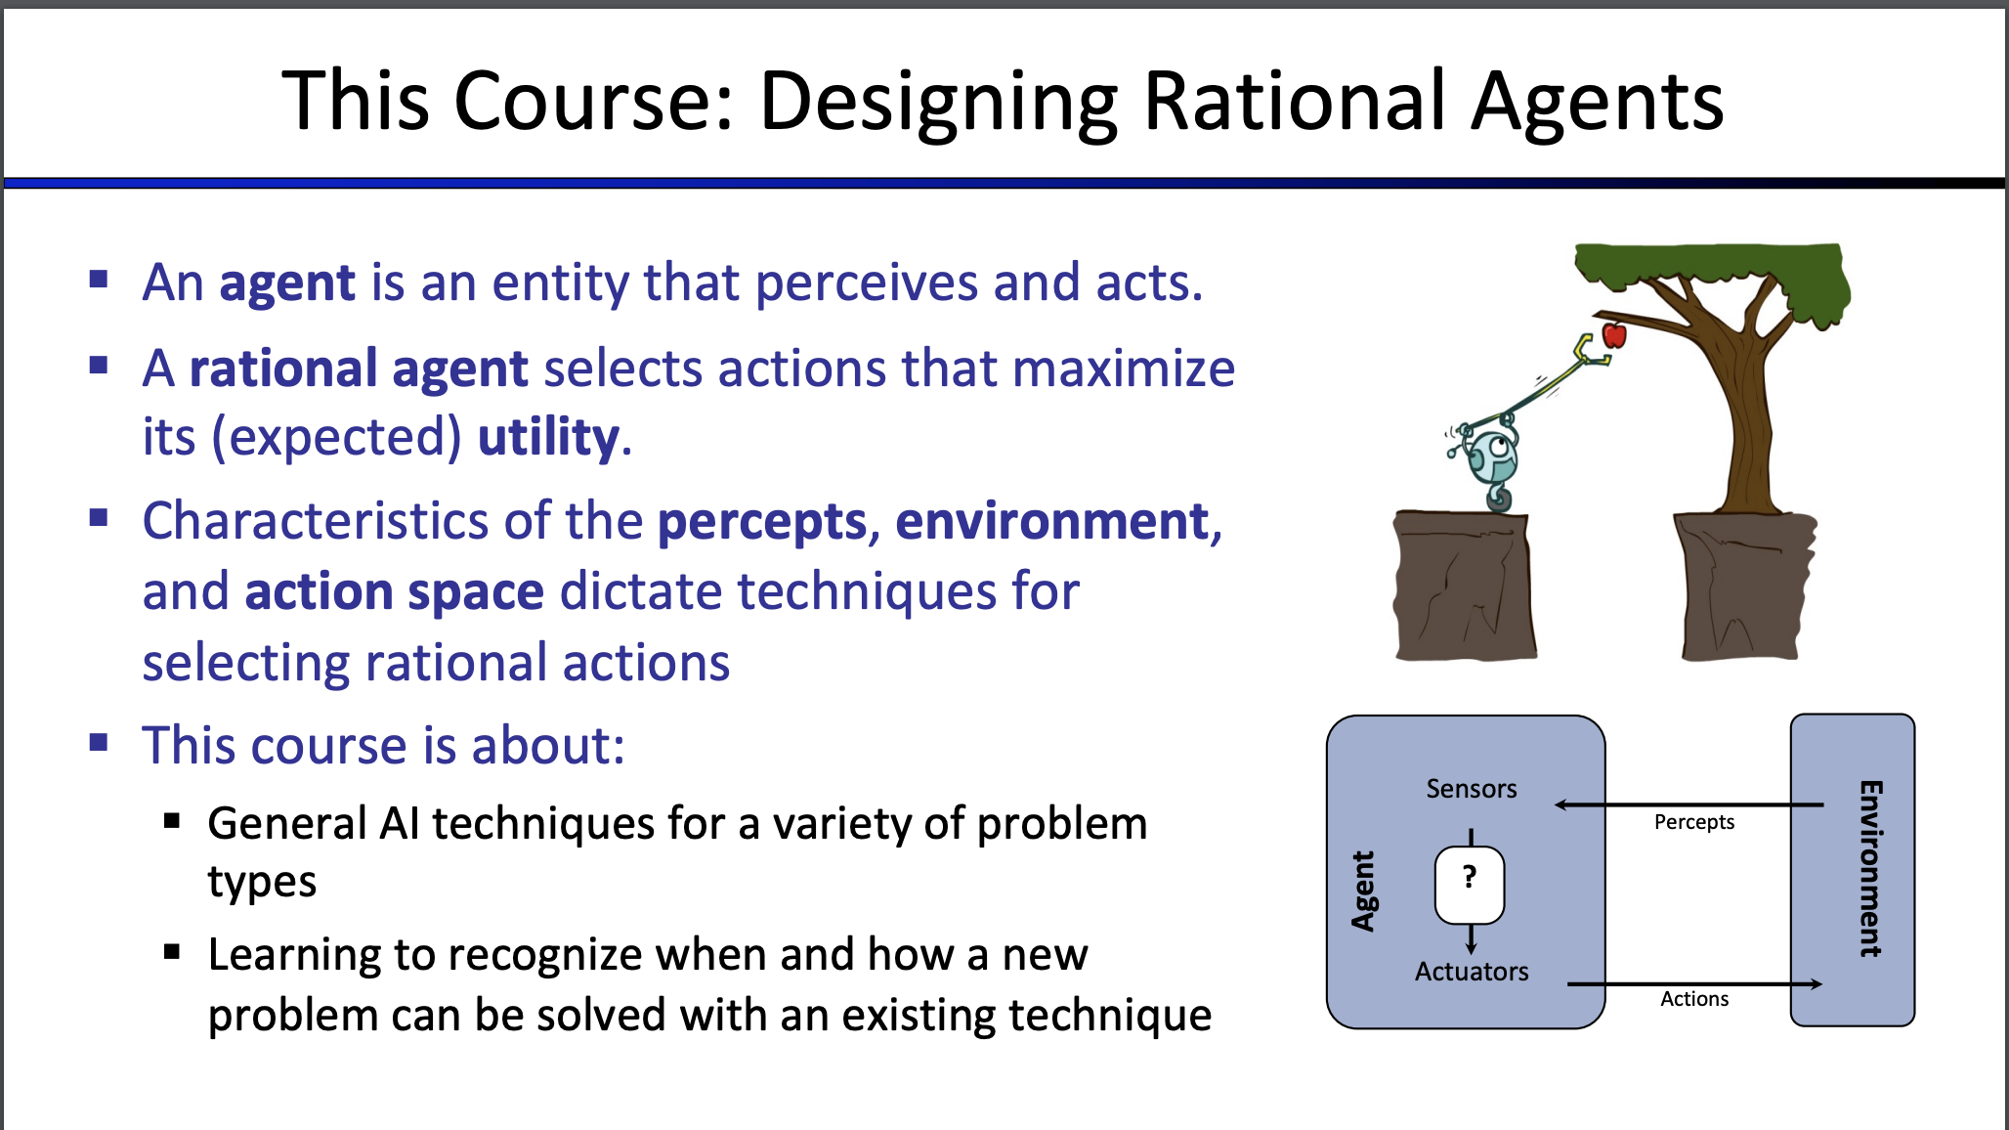
Next Class

Slide 125
Course Goals
Be introduced to some of the core problems and solutions of AI (big picture)
Learn different ways that success and progress can be measured in AI

Slide 126
Course Goals
Be introduced to some of the core problems and solutions of AI (big picture)
Learn different ways that success and progress can be measured in AI
Relate to other CS fields/disciplines

Slide 127
Course Goals
Be introduced to some of the core problems and solutions of AI (big picture)
Learn different ways that success and progress can be measured in AI
Relate to other CS fields/disciplines
Implement AI programs

Slide 128
Survey
There will be a survey posted in Blackboard
The purpose of this anonymous survey is to find what materials we should focus on and how would I design later part of the syllabus
Sample questions:
Why are you taking this course?
Have you developed AI/ML projects before?
Which courses are you taking from AI and ML this semester?

